Slide 1
Living on the Edge of the Singularity:
Looking at the Future of Higher Education
Ollivier Dyens
Deputy Provost
McGill University
LSU, March 201615
Notes:
Thank you for inviting me. Thank you to my great friend and great scholar Alexandre Leupin who invited me. A true great scholar, a true renaissance man. When I first met him he was, and still is, a medieval scholar. Then we created, right here at LSU, one of the first ever website on cyberculture, called Metal and Flesh. And now, Alexandre has become a great expert in Francophonie. Truly remarkable.
Thank you to Kate, his wife, for her support and welcoming. Thank you also to my wife who’s my strongest supporter and ally.
And thank you to LSU. I’ve spent some of the best years of my life here
Will there still be a university in 2050? Yes, but a very different one. And this is what we will explore.
This presentation will focus on the following:
-a short summary of some of the challenges we are facing
-a short analysis of the tensions points
-possible ways to move forward

Slide 2
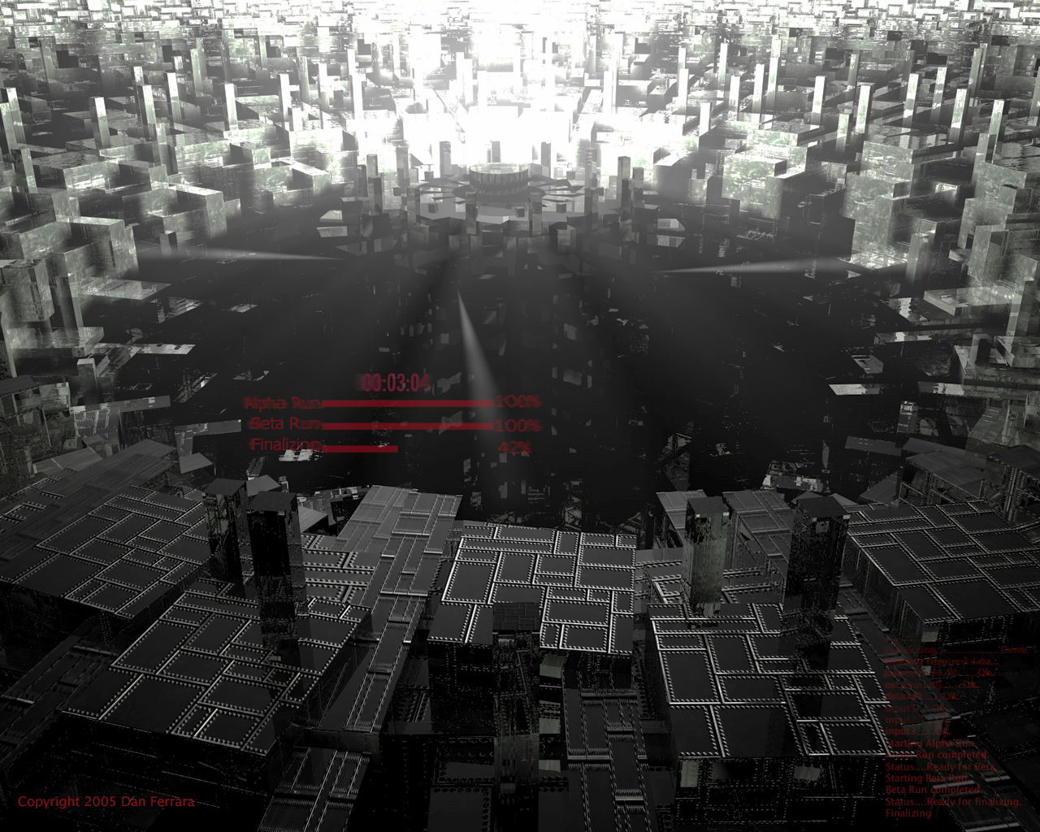
State of Things
    To express this another way, we won’t experience one hundred years of technological advance in the twenty-first century; we will witness on the order of twenty thousand years of progress (again, when measured by today’s rate of progress), or about one thousand times greater than what was achieved in the twentieth century.’ Kurzweil (2005), p. 11
Notes:
Let’s set the table: you think we are in the middle of a technological revolution?
Well the revolution has not started.
We are on the cusp of a world that will soon be dramatically different.
Ai, Big Data, 3d Printing, CRSPER, VR, Internet of Things, etc.
Technology will become an ecosystem, the human machine ecosystem
New economy: Uber, human cloud, on time manufacturing
The real and the virtual will be indistinguishable
Life expectancy
In the meantime, we have the same education system :
We move along as if nothing is happening.
We tweak things here and there, but never truly reframe what we do
Rigid (credits, schedule, lectures, semesters, etc.)
One size fits all
Same skills

Slide 3
State of Things
The non-mediated world has become a loss country; it’s a country that we cannot find our way back to. There is a pervasive sense of loss and a pervasive sense of excitement at what we seemed to be gaining. They are parts of the same feeling: this sense of loss and this sense of Christmas morning at the same time.
William Gibson interviewed in No Maps for these Territories
Notes:
We are on the brink of seeing the world completely differently.
We are beginning to think, love, socialize, perceive the world through machines.
Techno= 3rd hemisphere
We cannot have an education system that is non mediated anymore

Slide 4
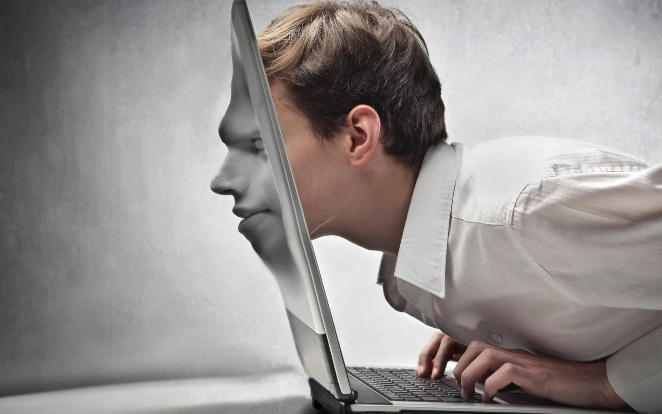
Major Ethical Challenges
Notes:
Ethic :
Google Car
Robotic: Drones
Who owns data?
What to do with data? (e.g. students at risk of failing)
Economy:
Stratification and speed (financial crisis)
Workers work conditions (Uber)
Mental:
Mental breakdown: real and virtual, social media, competition
Governance:
Governance from another century:

Slide 5
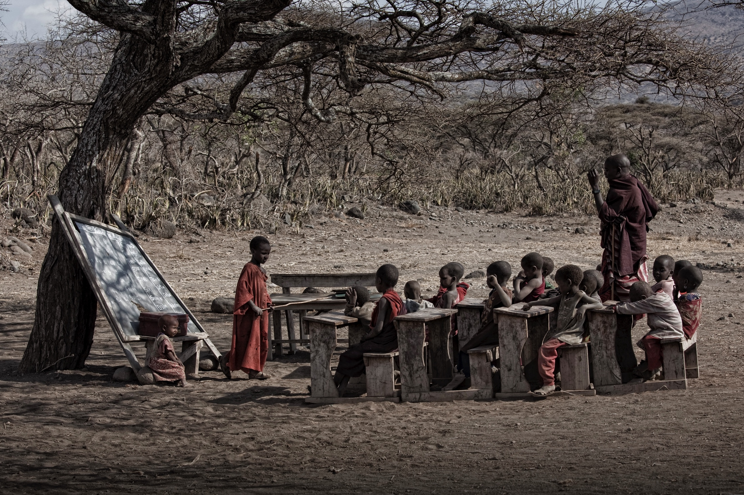
Education
  What is education when closing in on the technological revolution?
  What is knowledge and information at and beyond the technological event horizon?
  What is free will and responsibility when machines are making all of our decisions?
  How does one develop maturity, ethics, justice, equality, and fairness in a human/machine ecosystem?
  What skills and abilities do we need to develop?

Slide 6
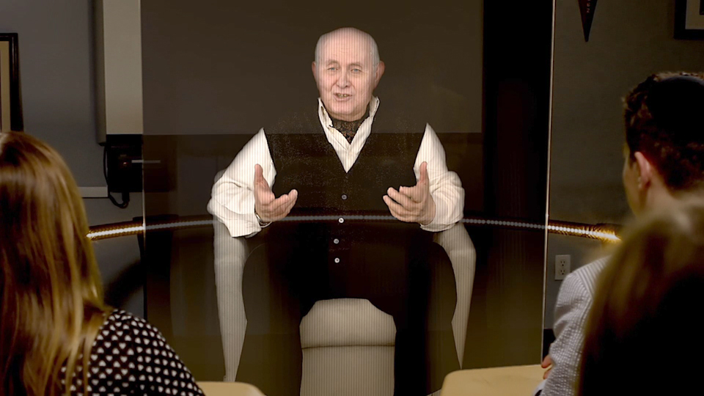
Education in 2050
https://www.youtube.com/watch?v=H46uOwLvWa0
Notes:
Stop at 3
Let me provoke you
At the 2050 conference, everyone said: the core is the human to human interaction
Really?
Imagine: Profs available everywhere, at any time, answering any question
What is the added value of human to human interactions?
Why should we continue teaching?

Slide 7
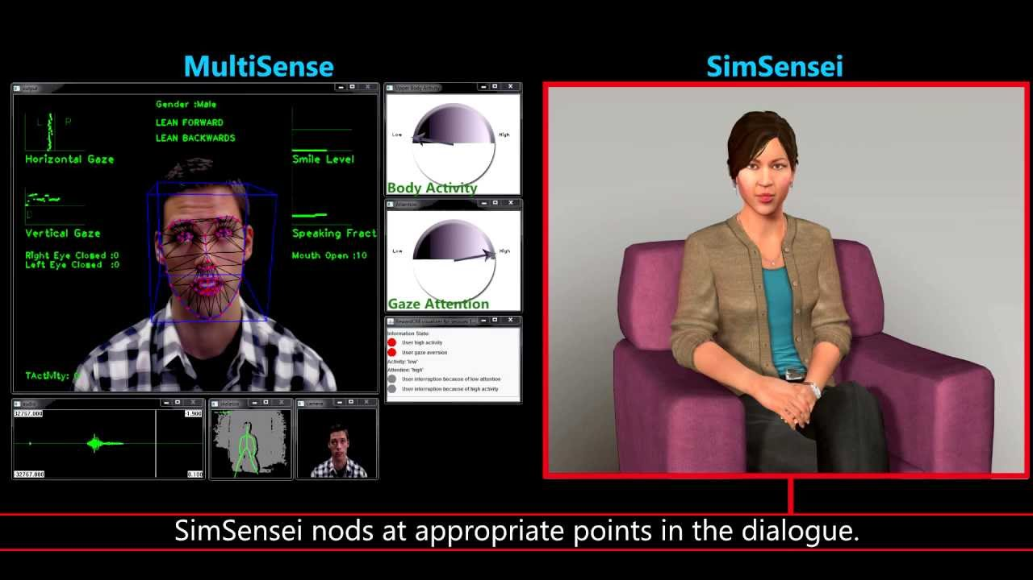
Education in 2050
https://www.youtube.com/watch?v=ejczMs6b1Q4
Notes:
Stop at 2:
Reading emotions
Available on an IPAD

Slide 8
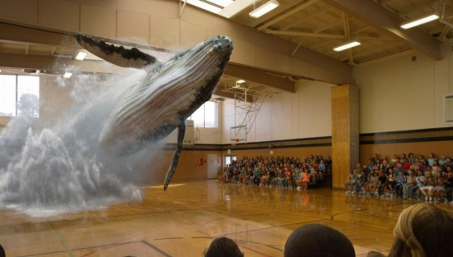
Education in 2050
  https://youtu.be/Ln6TZ14xITg
Notes:
Perfect merge between the real and the virtual
Education everywhere: everything communicates
The campus? The professor? The Social interaction?
Intrusion of the imaginary into reality

Slide 9
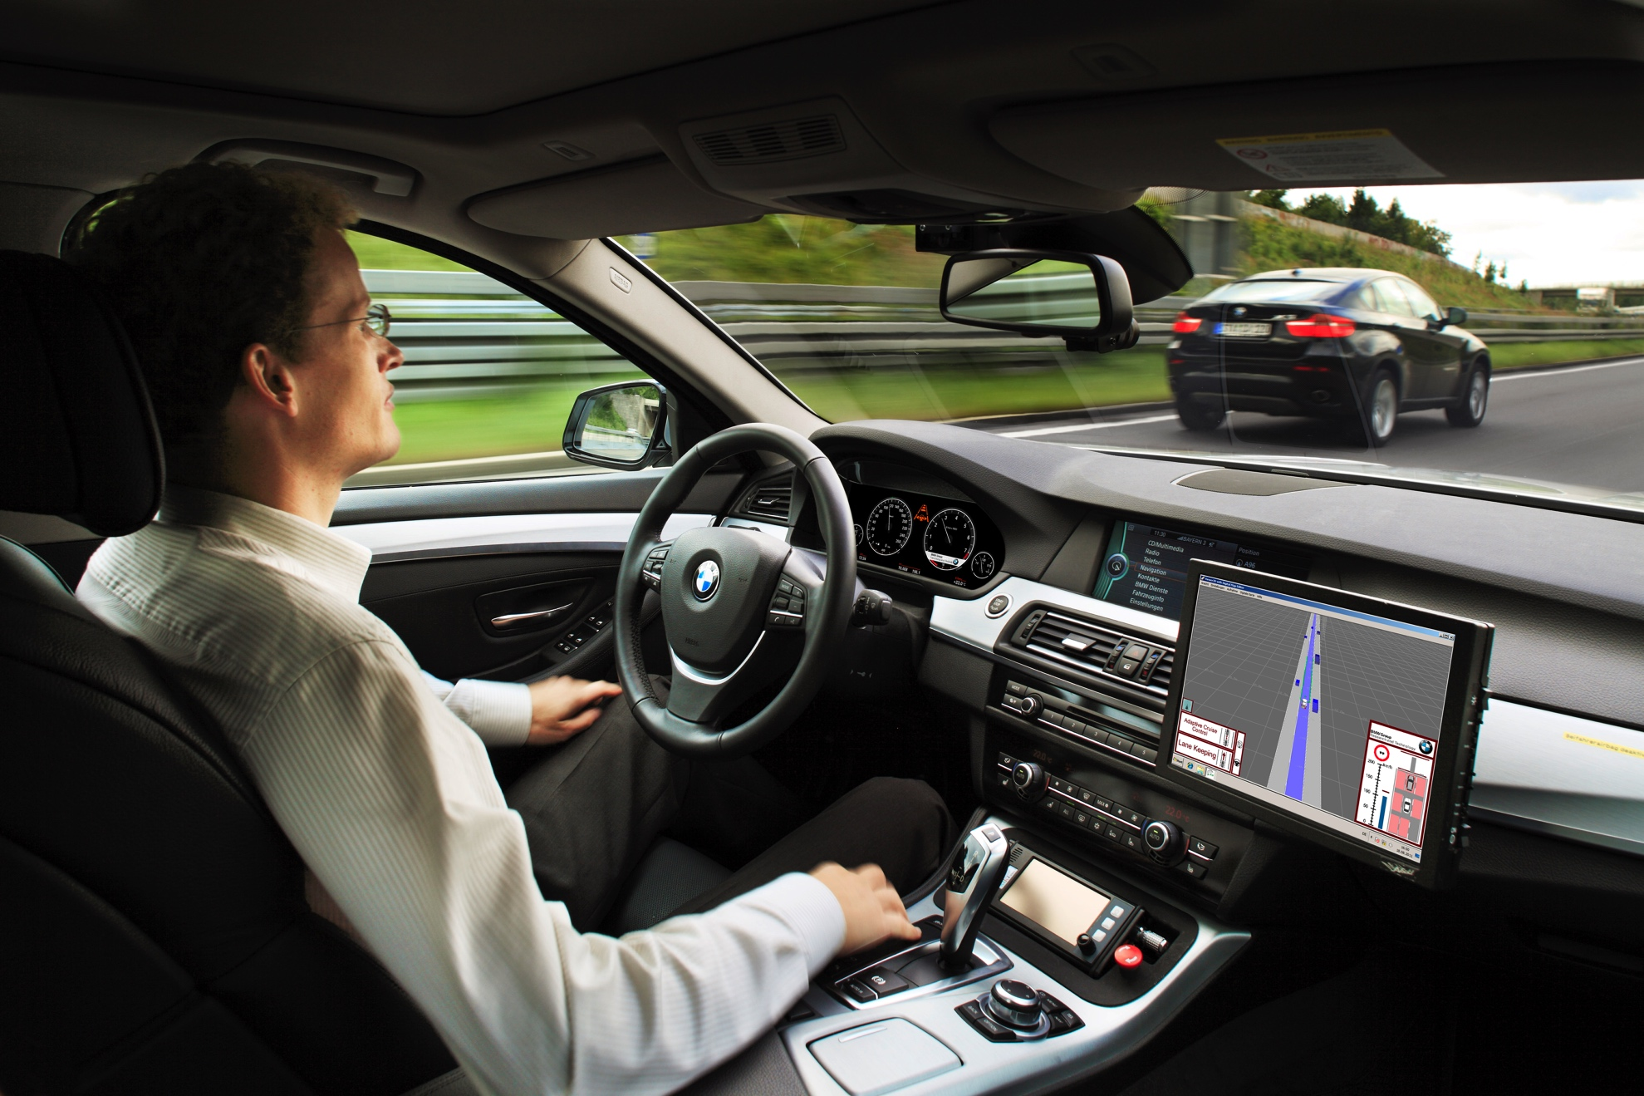
Fantasy?
Notes:
the fail promises of AI in the last 50 years?
before Big Data. Deep Blue, Watson, highly performing networks, Nuanced AI, Deep Learning AI, frightening life-like robots, computers that learn from experience.
before the self-driving Google Car.
You’re driving your car?

Slide 10
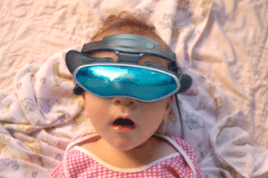
Urgency
Notes:
We absolutely need to rethink our education system,
But this will not be achieved using current methods
Sitting on the shoulders of giants
Emphasize what we do better than machines
Use them to enhance civilisation

Slide 11
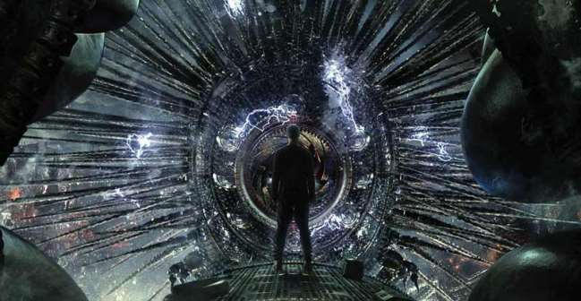
New Ways to Move Forward
Notes:
Two ways to move forward:
-using machines to access new understanding
Using art to enhance our human specific abilities

Slide 12
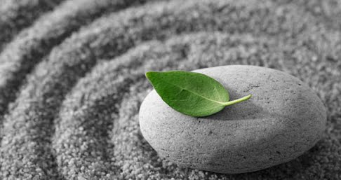
The Human/Machine System
How can they help us?
What do we do better than machines?
Notes:
How can machine help us?
Simplify, see, understand complexity (brain, viruses, pandemics)
See new dimensions (micro and macrocosm)
Beyond our embodied brain
Software that reads thousands of scientific articles
new understanding: (Watson : cuisine)
solution to wicked problems : environment, brain, diseases
Better than machines?
Ambiguity
Emotion: Damasio : Descartes’ Error
Generalisation
Wisdom
Creating hypotheses
Desire to survive
Empathy and compassion
Metaphysics
Creativity and unexpectedness

Slide 13
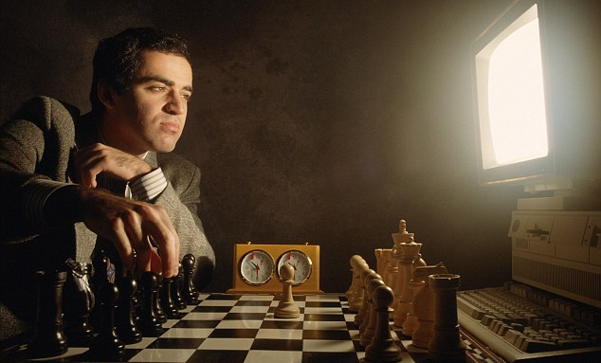
Kasparov
Notes:
Kasparov and chess. : team: humans and machines
Finding new patters: with man and machines
This is the way

Slide 14
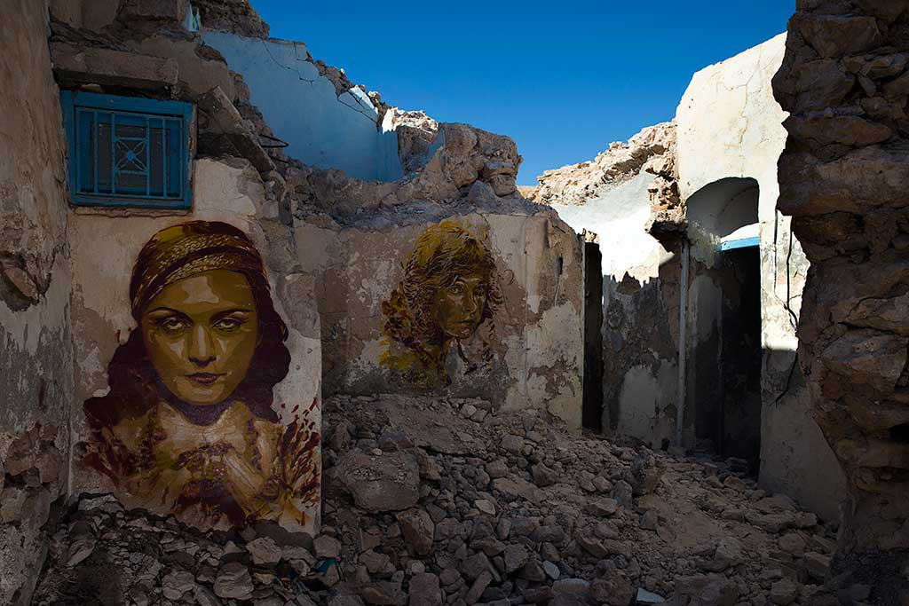
Using Art to Enhance the Human/Machine System
‘‘There was not enough time for human heredity to cope with the vastness of the new contingent possibilities revealed by high intelligence,’ E.O. Wilson says : ‘The arts filled the gap,’ allowing human beings to develop more flexible and sophisticated response to new situations.’
Denis Dutton (2009): The Art Instinct, Bloomsbury
Notes:
Let’s go back in time:
30 to 50,000 years ago,: the cultural big bang. Language, symbols, religion appeared,
our brains turned us into a new species.
to cope with this? We went underground and started paintings and drawing and probably chanting.
My suggestion is that we do the same today.

Slide 15
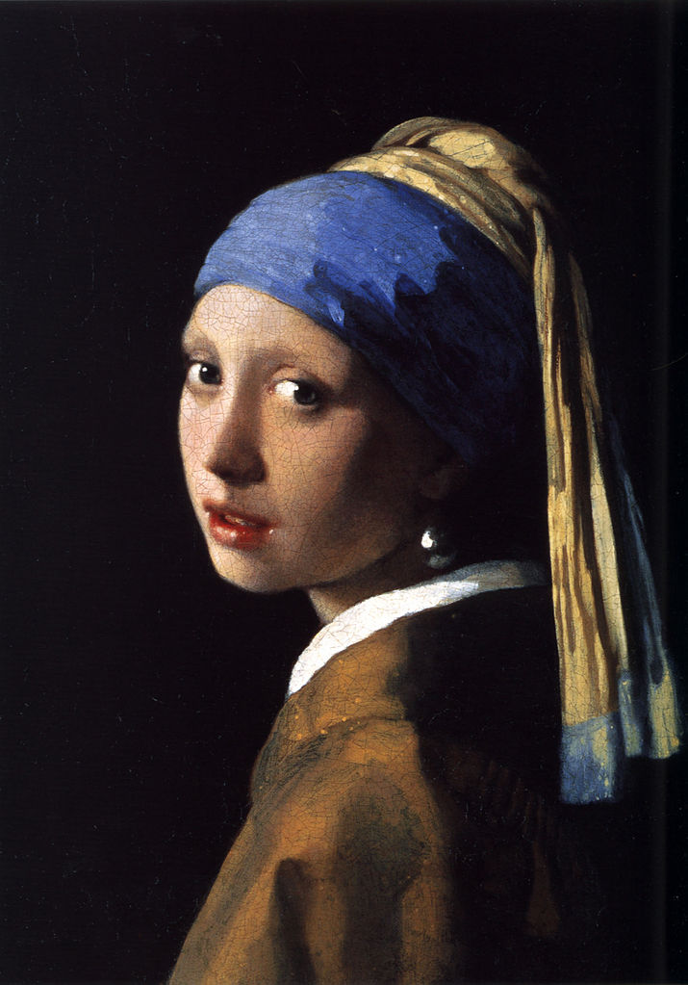
Art as a Survival Mechanism
Why do we think art is beautiful?
“‘Pleasure’ is not something that natural selection doles out without a reason – and we would expect that reason to be intimately connected with maximising fitness.’ David. P. Barash
Notes:
We are emotionally drawn to structures, forms and narratives that increase our rate of survival.
we are enticed by forms, shapes, rhythms and movements that are useful to our existence
We like the girls with he pearl earing because she is symmetrical, beautiful skin, young and because of the composition: exploring, contrasts,
Through art, the individual and the collective become more tolerant, innovative, and stable, allowing for an extended lifespan.

Slide 16
Art as a Survival Mechanism
‘There is virtually no evidence that artworks activate emotion areas distinct from those involved in appraising everyday objects important for survival. Hence, the most reasonable evolutionary hypothesis is that the aesthetic system of the brain evolved first for the appraisal of objects of biological importance, including food sources and suitable mates, and was later co-opted for artworks such as paintings and music.’
Brown and Gao (2011): September 27

Slide 17
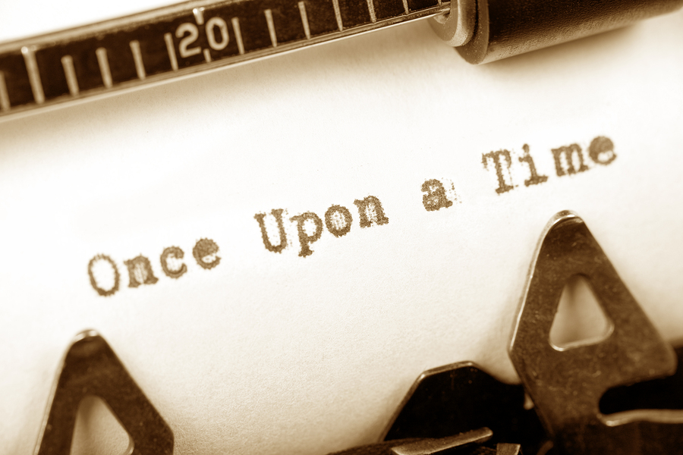
Art as a Survival Mechanism
We like stories because they simulate social interactions

Slide 18
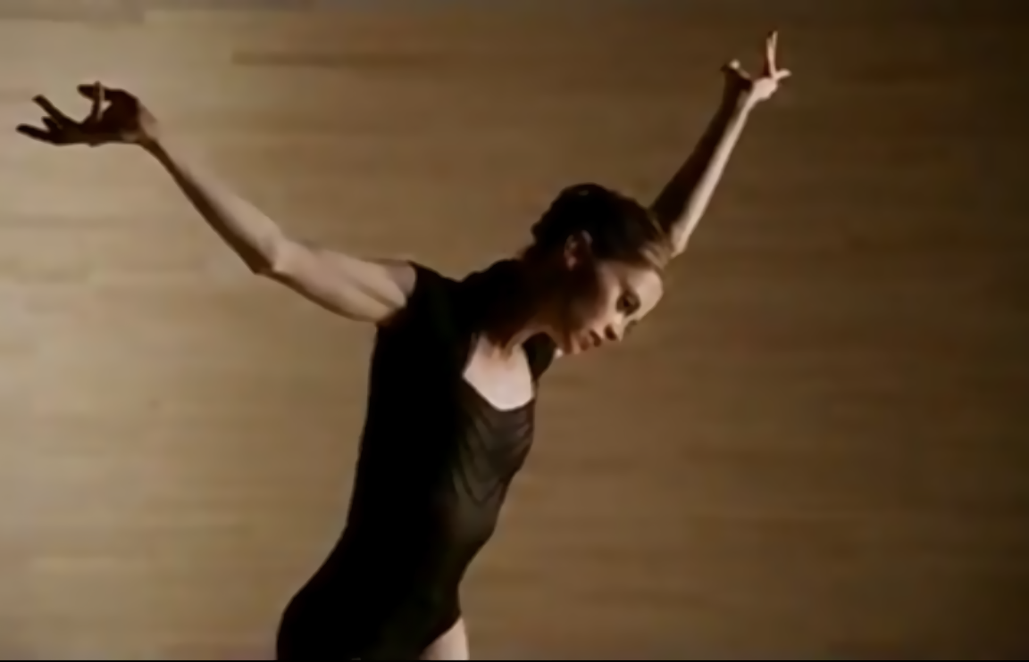
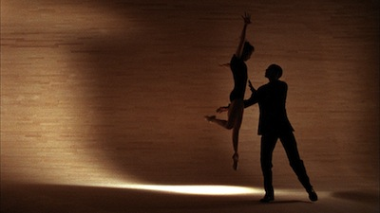
Art as a Survival Mechanism
When we are drawn to a work of art, when we label such a work as beautiful, touching, or inspiring, we, in effect, filter through our senses and cognition the survival effectiveness of the art form we experience.
Notes:
Effectiveness of movements. Saving energy
The hunter must save energy. Do the best possible movement
And focus

Slide 19
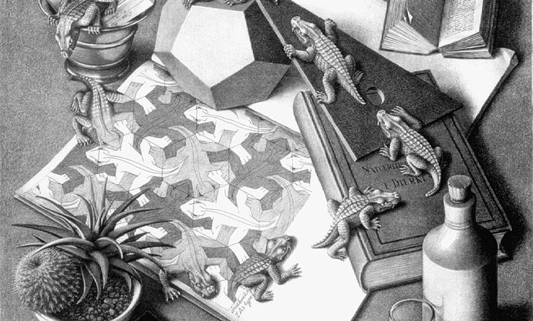
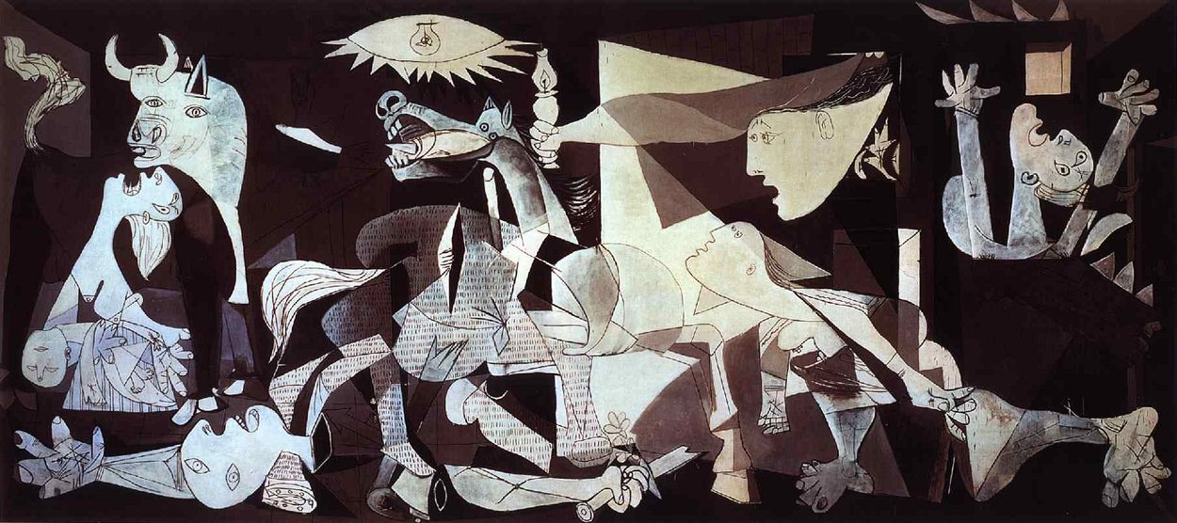
Art as a Device
Notes:
metaphors, analogies, play on words, and allegories
draw unusual elements together to produce innovative shapes, dynamics and phenomena.
manage the colossal amount of information
Narratives = better social coherence
selecting and understanding what is useful through the clutter (common sense), binding unusual elements together effectively

Slide 20
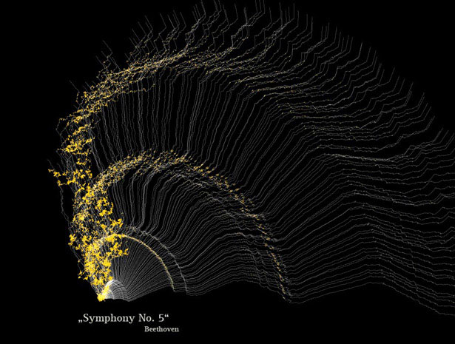
Where Do We Go from Here?
The tension lies in the structure
  Structures impose thought patterns
Use new solutions to new problems
Notes:
Next 10 years?
Themes based degrees
New schedules
Rethink the PhD
Look at the tension between access and research

Slide 21
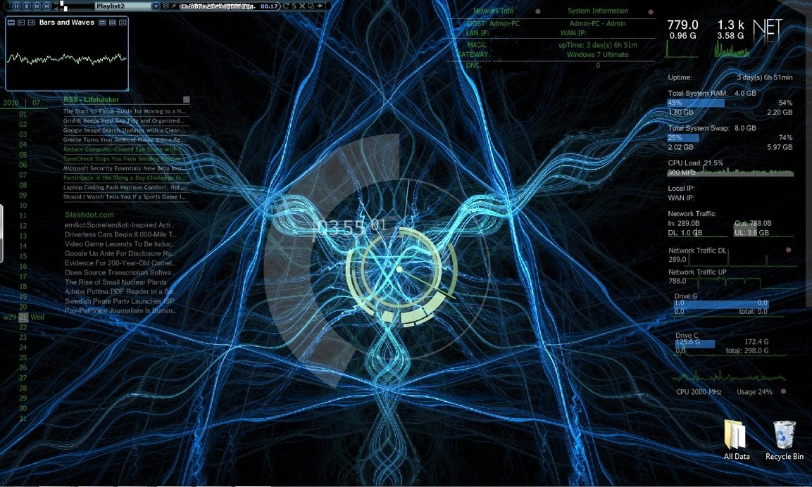
Reconceptualising
Notes:
We are co-evolving with machines: accept it:
I.e.
Amalgamate intelligences: machines, humans, the microbiome’s
Embrace Intelligence Amplification: 3rd hemisphere
Look 50 years down the road: Do not focus on improvement to the combustion engine
Emphasise the human strengths: art, ambiguity, compassion, emotion
Acknowledge the rise of new human cognitions (mental disorders)
Think of environments (hard and soft; man made and natural) as layered, intelligent and intertwined but not distinct: rethink the campus
Accept that machines will be better teacher: we need to be enhance human abilities
Use aesthetic as quality control mechanisms for assessing natural, man made, and machine generated ecosystems

Slide 22
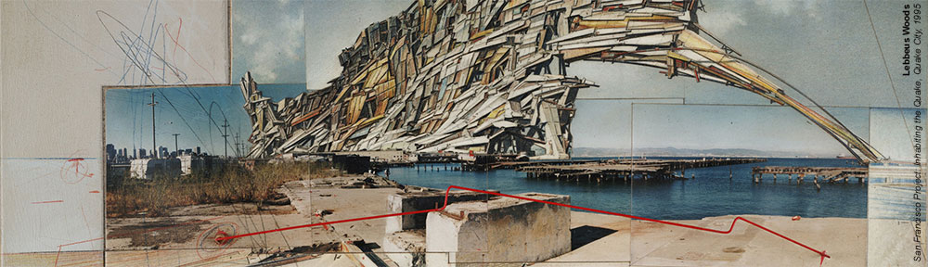
New Assumptions
What would a university look like if it were build like
    a swarm, a video game, an operating room?
    DNA?
    A beehive or an anthill?
    An opera?
    A living organism?
Notes:
A university like a membrane.
Permeable, fluid, using machinery (the body uses the machinery of DNA; education needs to use the machinery of AI)
Collective intelligence
A-centered (like beehive)
beautiful

Slide 23

Thank you

