Slide 1
What are humanities in a world where humans as we know it have disappeared?
Ollivier Dyens
Deputy Provost
McGill University
LSU, March 2016

Slide 2
Your trillions of cells—only 10 percent of which, remember, were yours anyway—will become parts of trillions of things. And even the 10 percent wasn't really yours to begin with. You were only borrowed. We've had it backward all along: the body is immortal—it is the soul that dies.
Quinn (2011)

Slide 3
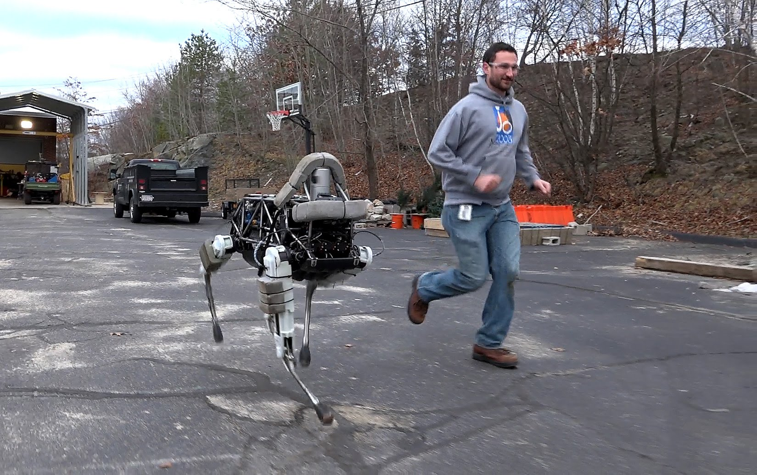
21st Century

Slide 4
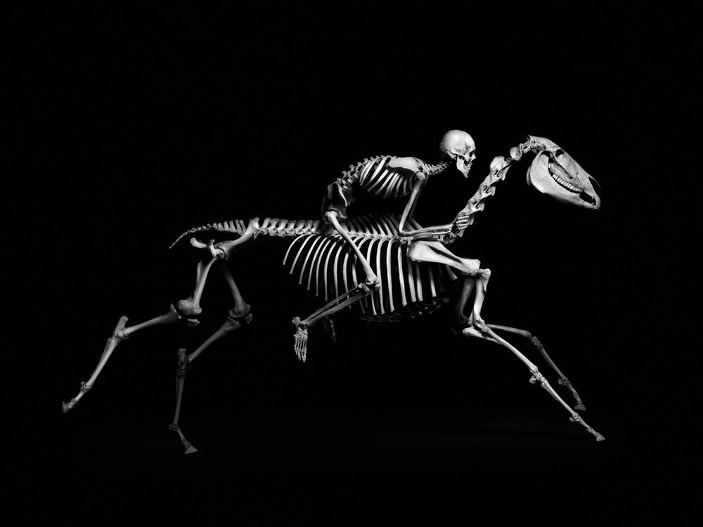
Evolution

Slide 5
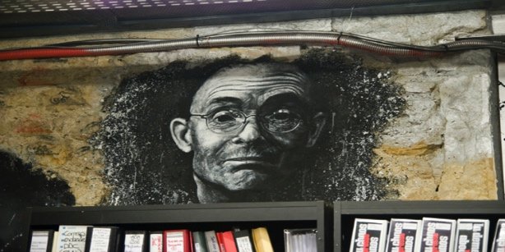
The Terror and the Ecstasy
https://www.youtube.com/watch?v=pSnPa1mWgK0
Notes:
9:19 t0 15

Slide 6
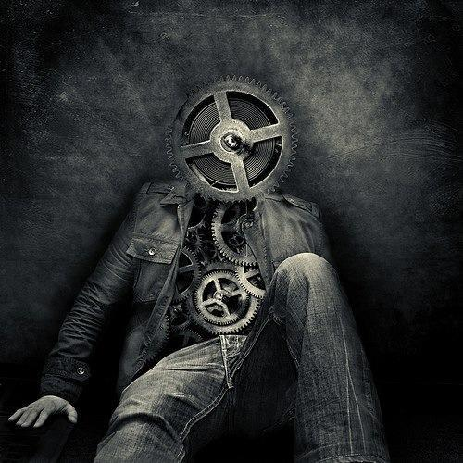
Slippery Foundations
Boundaries
Permanence
Human intelligence
Geology
Ontology
Notes:
9:19 t0 15

Slide 7
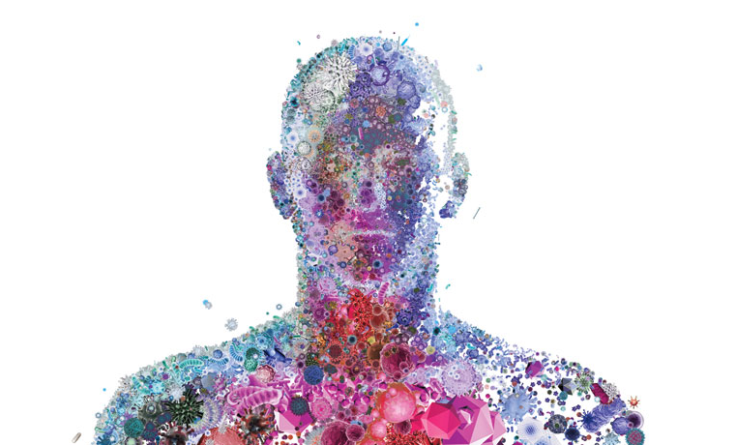
Rethinking the Foundations

Slide 8
The Reframing
The human body isn’t besieged; it’s saturated, infused, with microbial life at every level. ‘There is no such thing as an individual’, Lynn Margulis, a biologist at the University of Massachusetts at Amherst, told me recently. ‘What we see as animals are partly just integrated sets of bacteria.’
Bilger (2011)

Slide 9
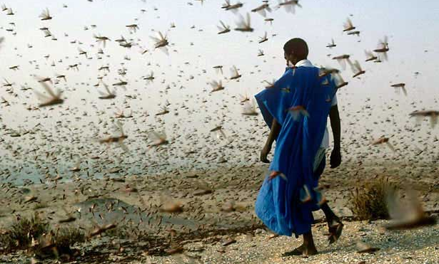
The Reframing

Slide 10
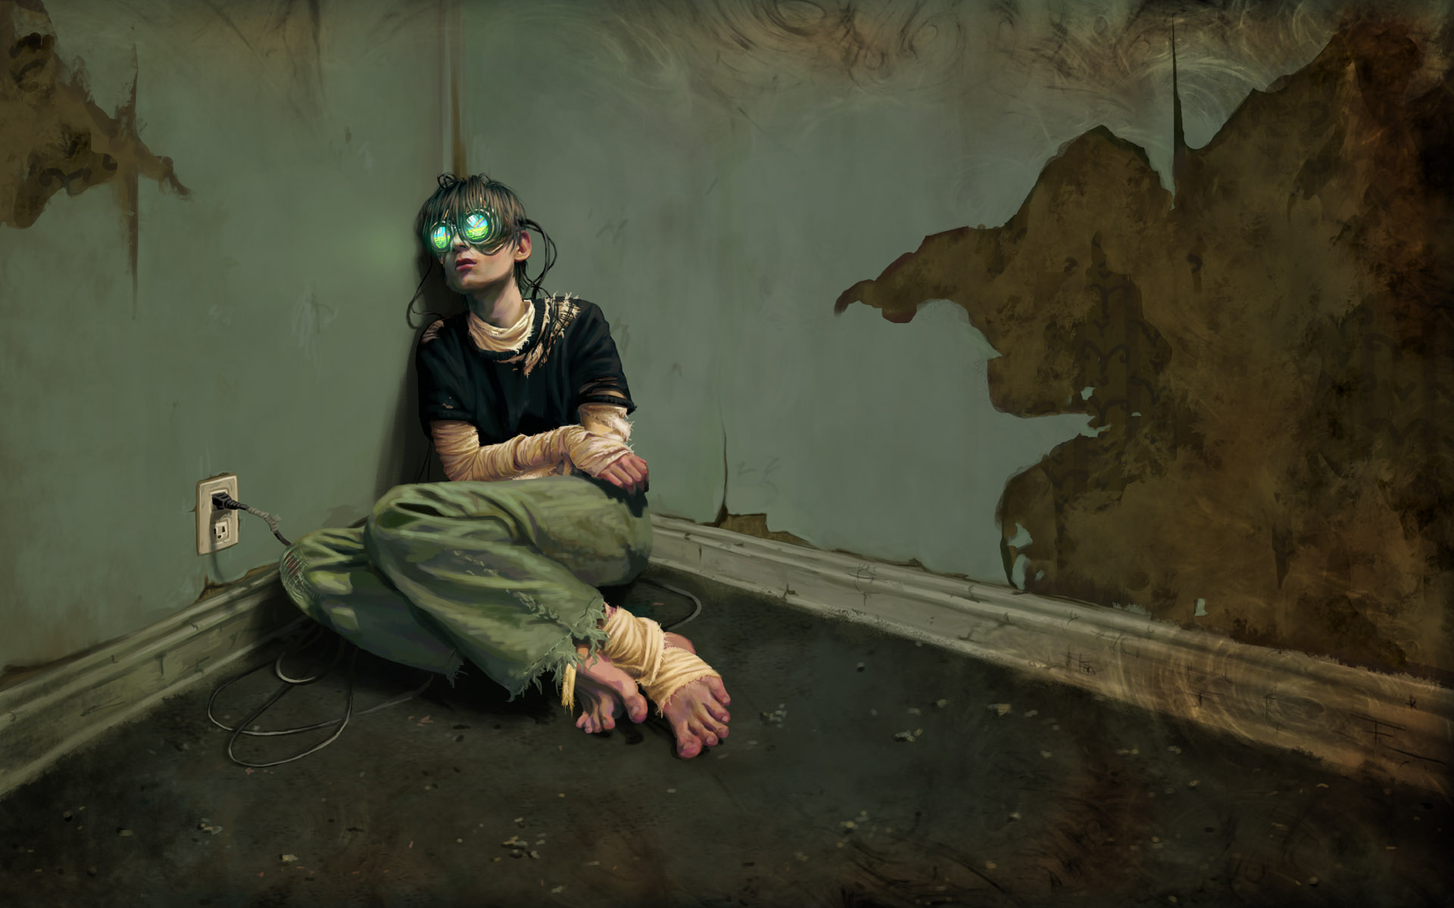
Humanities in the 21st Century

Slide 11
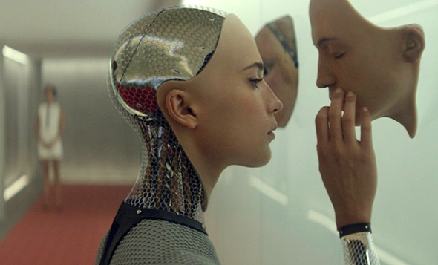
Humanities in the 21st Century

Slide 12
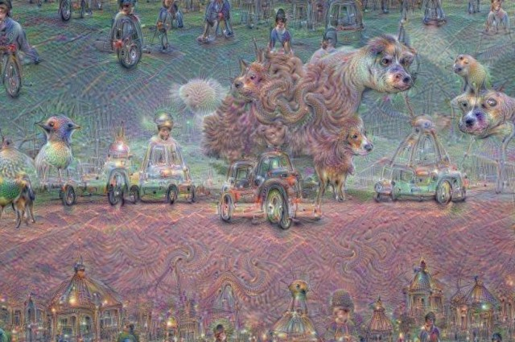
Humanities in the 21st Century

Slide 13
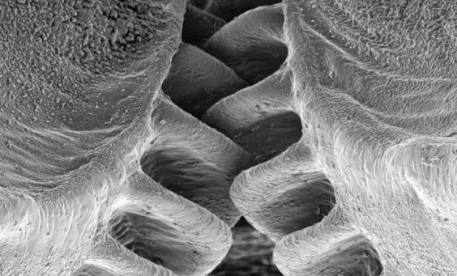
Humanities in the 21st Century

Slide 14
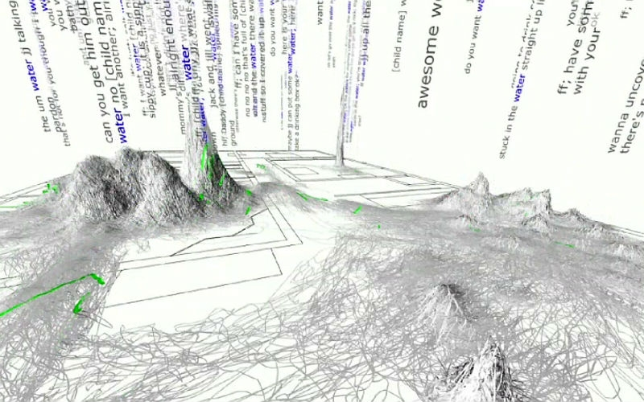
Humanities in the 21st Century

Slide 15
Conclusion
Pleasure is not something that nature doles out without reason and we would expect this reason to be intimately linked to maximizing fitness.
  David P. Barash (2013)

Slide 16
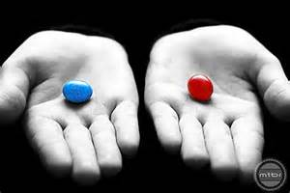

Slide 17

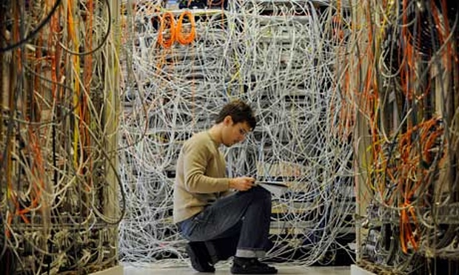
Thank you

