Slide 1
ASP Meeting
February 7, 2019
Jaime Estave, Director of SPA
ALL MATERIALS PROVIDED IN CONJUNCTION WITH THIS PROJECT MAY CONTAIN PROPRIETARY INFORMATION AND ARE FOR INTERNAL USE ONLY

Slide 2
Agenda
1
FY 18 Audit Finding –Key Personnel/Effort Reporting
2
Key Personnel Tracking in Workday – Coming Soon
3
Effort Certifications - Reviewing/Verifying
4
Workday Changes – Current & Pending
5
AS-21 Policy Update
6
Questions

Slide 3
FY18 Audit Finding

Slide 4
FY 18 Audit Finding:
Noncompliance with and Inadequate Controls over Federal Special Tests and Provisions Requirements:
- Key Personnel
- Effort Reporting

Slide 5
Key Personnel Tracking

Slide 6
Key Personnel Tracking
FY 18 Audit Finding
Balancing Key Personnel - budgeted commitments to actual expenditures
Key Personnel Tracking in Workday– (COMING SOON)
  Key Personnel Commitment tab
  Key Personnel Commitment report

Slide 7
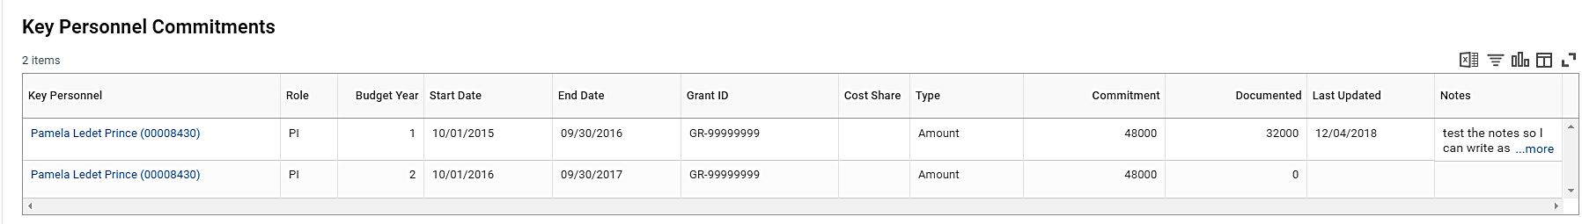
Key Personnel Commitment Tab – Coming Soon
The Key Personnel Commitments will be visible on the Award
A report with the ability to pull by Worker (Key Personnel) and dates will be available
As ledgers are audited, SPA will update the documented amounts

Slide 8
Effort Certifications

Slide 9
Effort Certifications – Effort Reporting
December 2018 ORED Announcement: Effort Certification and Reporting in Workday
Why is Effort Reporting Important?
  Effort reporting is a federal requirement. As a recipient of federal funding, LSU is required to verify that all payroll costs charged to federal agreements correspond to actual work (effort) performed on the sponsored agreement. This ensures external sponsors only reimburse LSU for the effort expended on projects.

Slide 10
Effort Certifications – Effort Reporting
Effort Certification in Workday:
The University supports the Effort Certification process in Workday as an after-the-fact reflection of an employee’s workload percent distribution during a particular reporting period. The employee (or his/her delegate with first-hand knowledge of an employee’s effort) must verify the accuracy of effort percentages and certify that the information captured on the effort certifications is a direct reflection of the work performed within the reporting period of certification.
Sponsored Program Accounting: On a quarterly basis, SPA prepares effort reports that are based on the payroll amount charged to the grant for the applicable timeframe.
Effort Certification Reviewer: Effort reports are first routed to an administrator known as an Effort Certification Reviewer (ECR) for a pre-review of the effort report to ensure the payroll charges correctly reflect the distributions as informed by the Investigator of the project. If changes are needed, the ECR will process the correction(s) before submitting the effort report to the employee for certification. If changes are not needed, the ECR will submit the effort report to the employee for certification.
Employee: If the effort certification properly reflects the employee’s effort performed for the time period, the employee will certify their effort. However, if a correction needs to be made, the employee should not certify the effort and instead work with the ECR to ensure a Payroll Accounting Adjustment (PAA) is created to correct the effort for that reporting period.
If a PAA is processed for an effective period in which effort has already been processed or certified, then the department needs to submit a request for the effort certification to be canceled and regenerated to effortassistance@lsu.edu. Once the effort certification is regenerated the employee will certify the new effort certification.

Slide 11
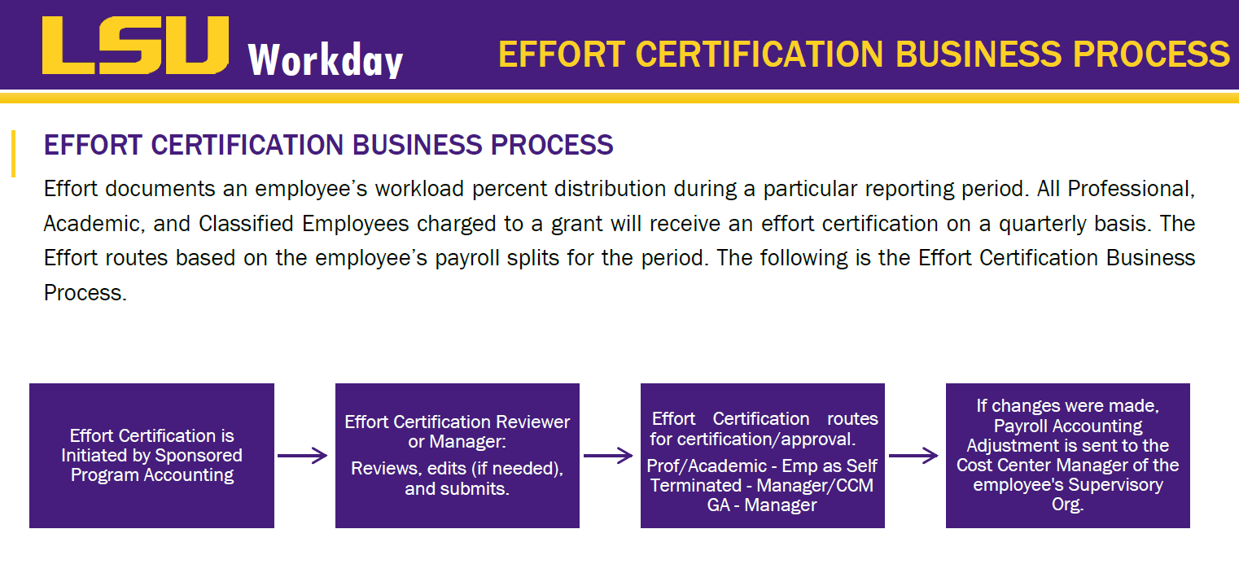
Effort Certifications – Business Process

Slide 12
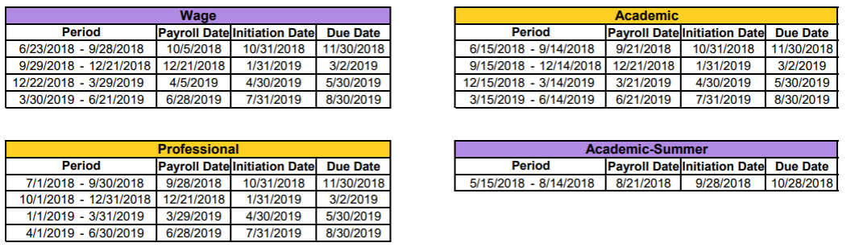
Effort Certifications – Effort Schedule
Employees are responsible for certifying on a quarterly basis that their salary distribution is an accurate reflection of the time worked for the period. Failure to complete and certify effort correctly and in a timely manner could result in loss of funds to the University. Therefore, it is imperative to certify all pending effort certifications timely.

Slide 13
Effort Reporting/Reviewing Ledgers Monthly:
Reviewing ledgers/accounts Monthly
  Expense by Award
  SPA Journal Line Detail
Effort Certifications are run Quarterly - EXAMPLE
  Ledgers/Reports: October – Reviewed in November
  November – Reviewed in December
  December – Reviewed in January
  Effort Certification:
  January 31, 2019 Effort Certifications will be generated for the Oct-Dec reporting period. Any PAAs generated during the above time frame we be reflective on the Effort Certification.

Slide 14
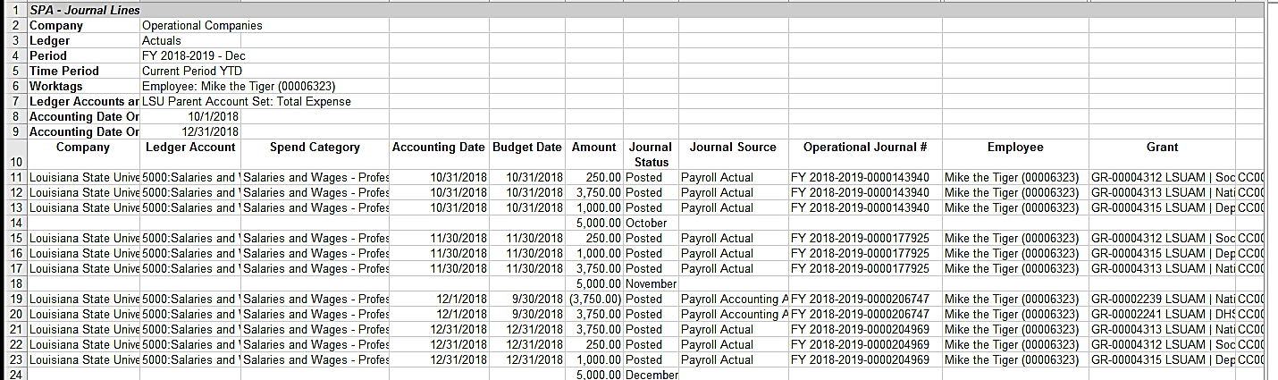
SPA – Journal Lines

Slide 15
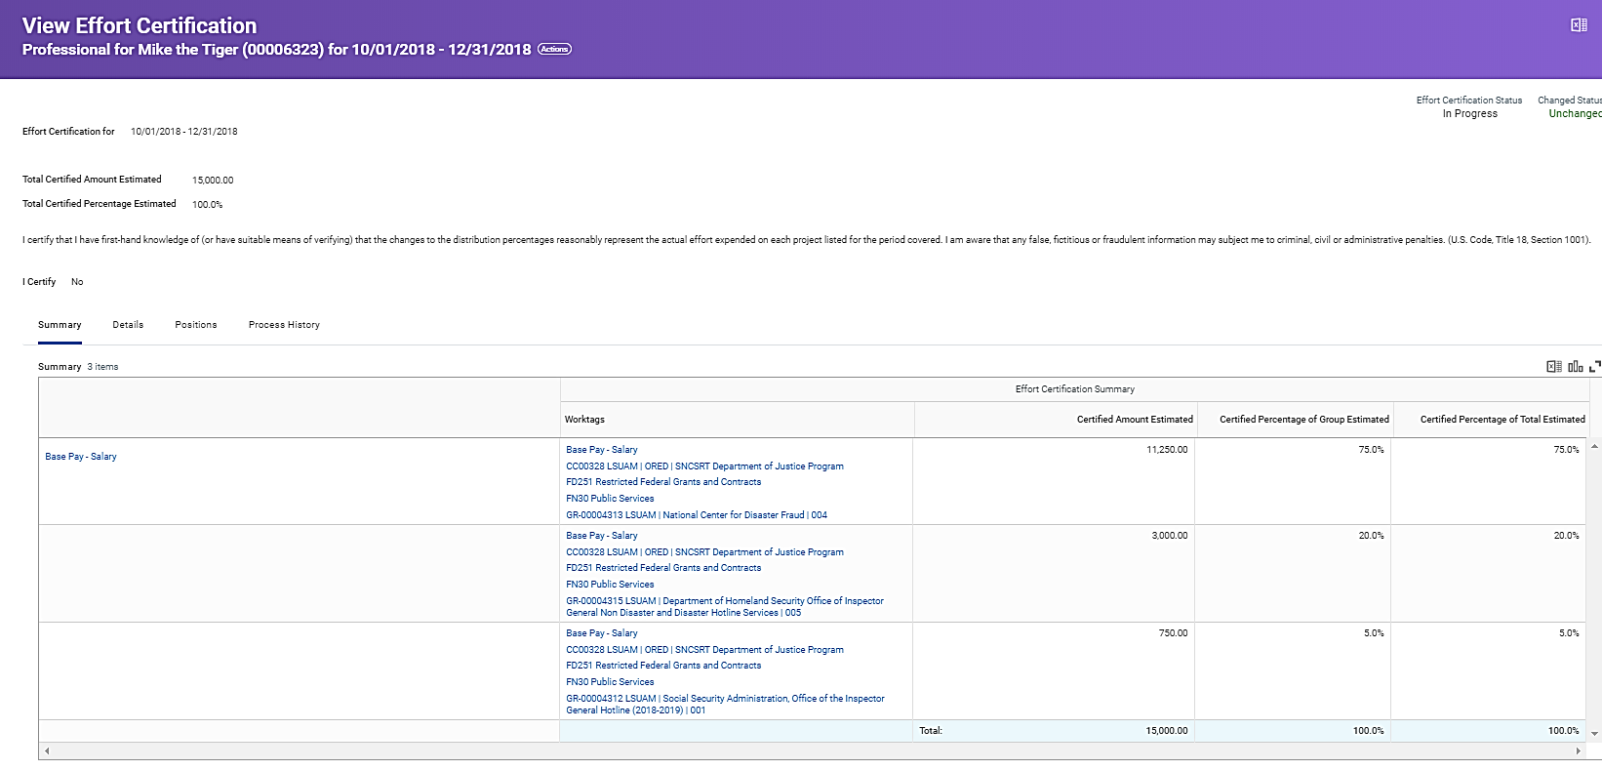
Review Effort Certification – Summary Tab

Slide 16
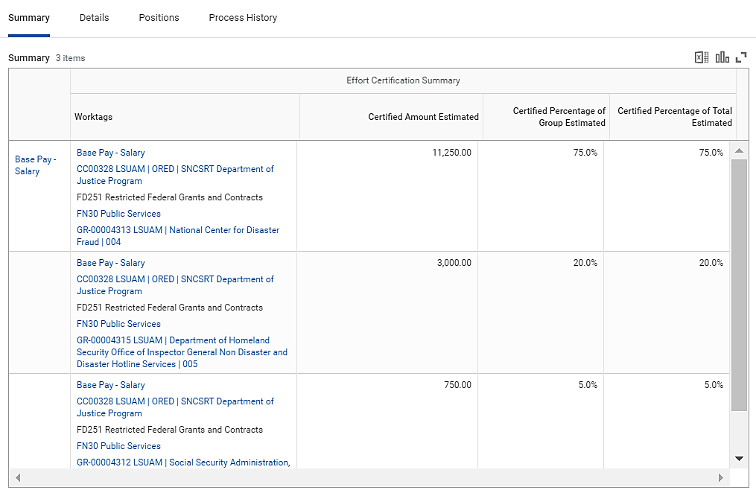
Reviewing Effort Certification - Summary

Slide 17
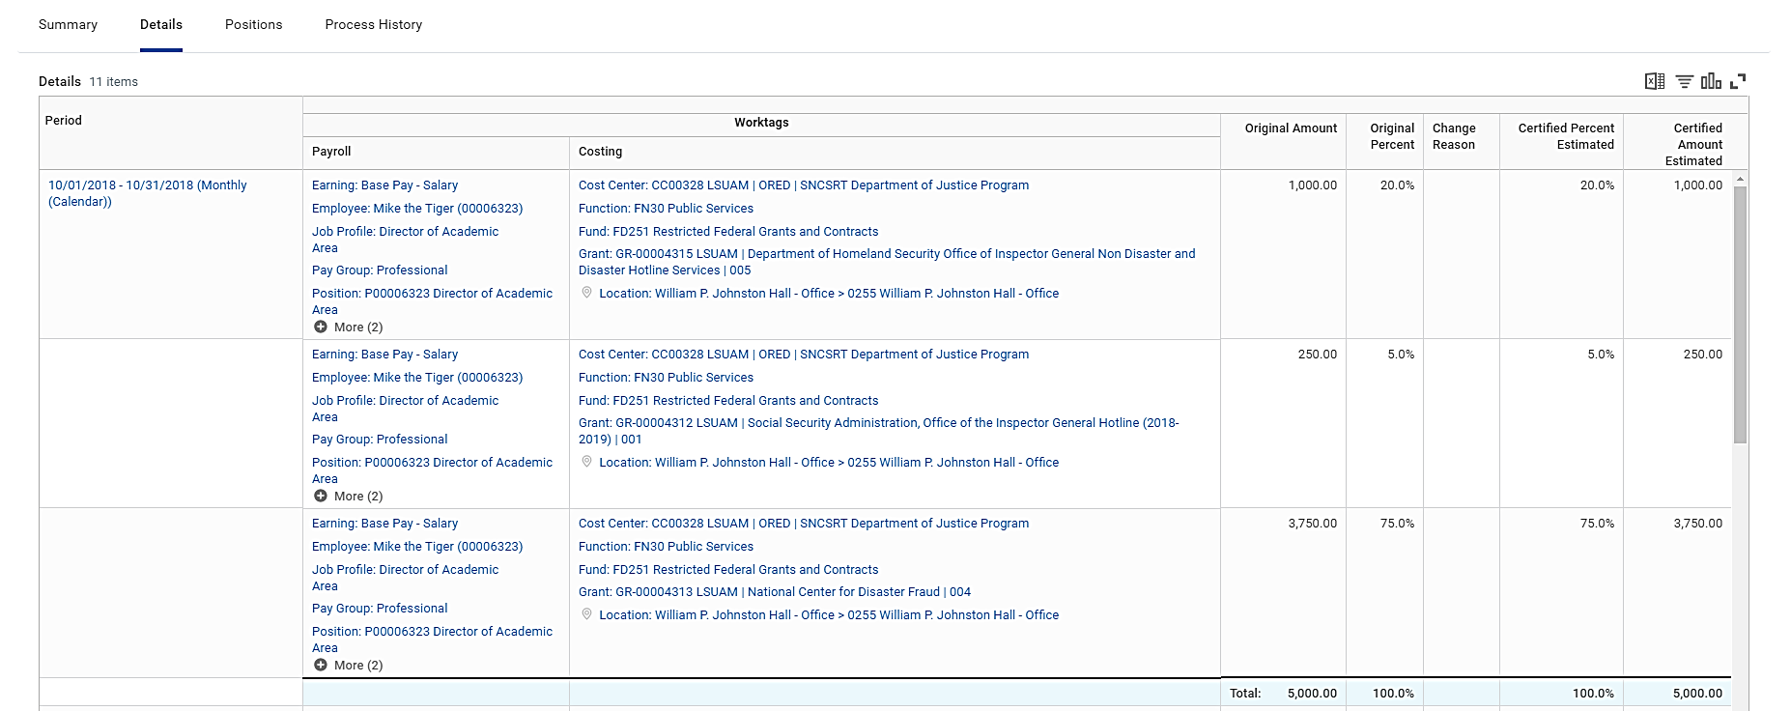
Review Effort Certification – Details Tab

Slide 18
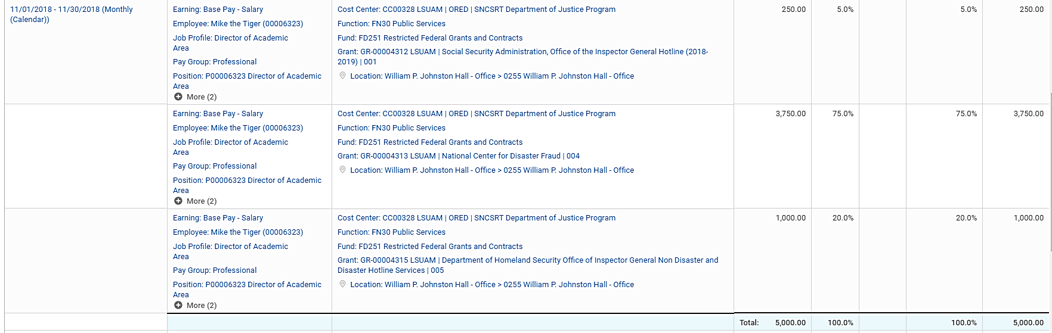
Review Effort Certification – Detail Tab

Slide 19
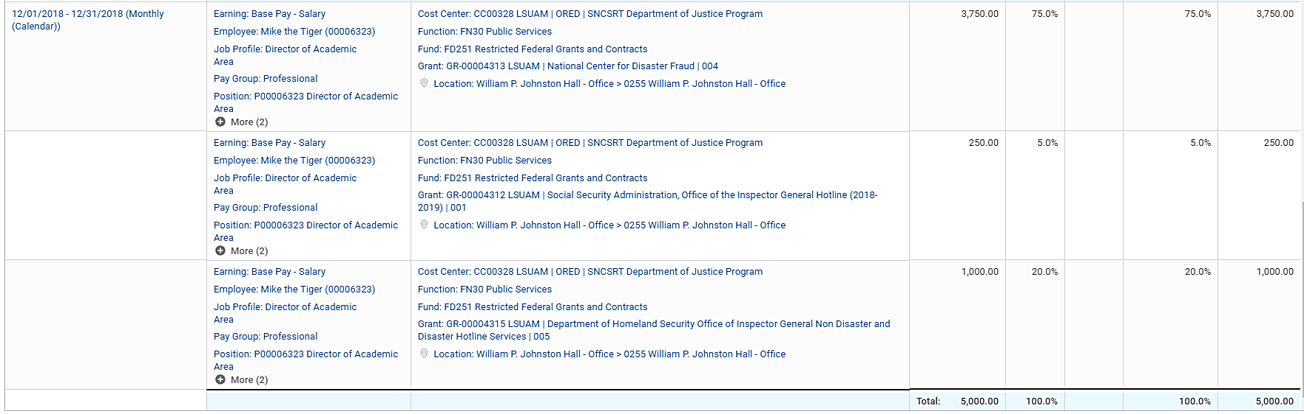
Review Effort Certification – Details Tab

Slide 20
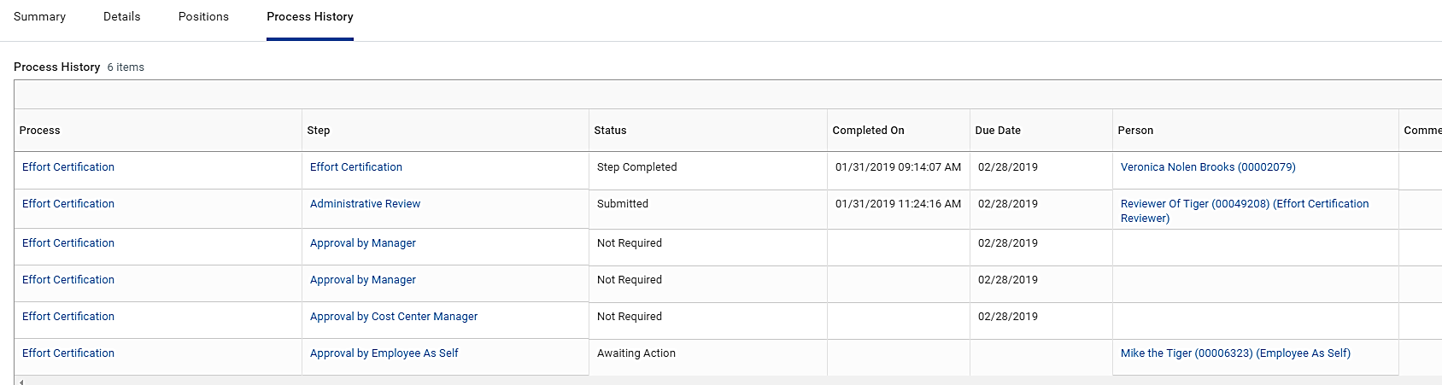
Review Effort Certification - Business Process

Slide 21
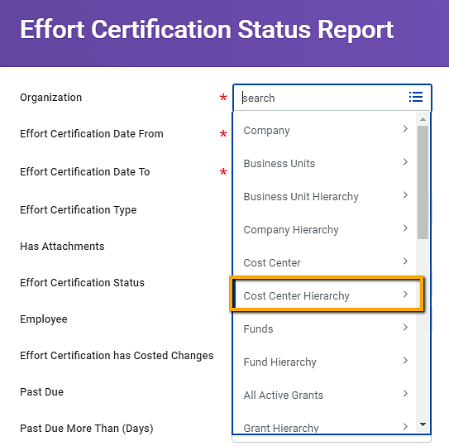
Effort Certification Status Report
Report can be run by:
  Cost Center
  Cost Center Hierarchy
  Employee

Slide 22
Workday Changes

Slide 23
Workday Changes – Current & Pending
Viewing Outstanding Invoices on Award Tab
Viewing Sponsor Invoices on Award
Workday Reports – Coming Soon/Work in Progress
Still in Developmental Stages – Reports displayed are subject to change
  Grant Balances Investigator
  Grant Balances Department
  In Progress
    Supplier
    Expenses
    Journal Entries

Slide 24
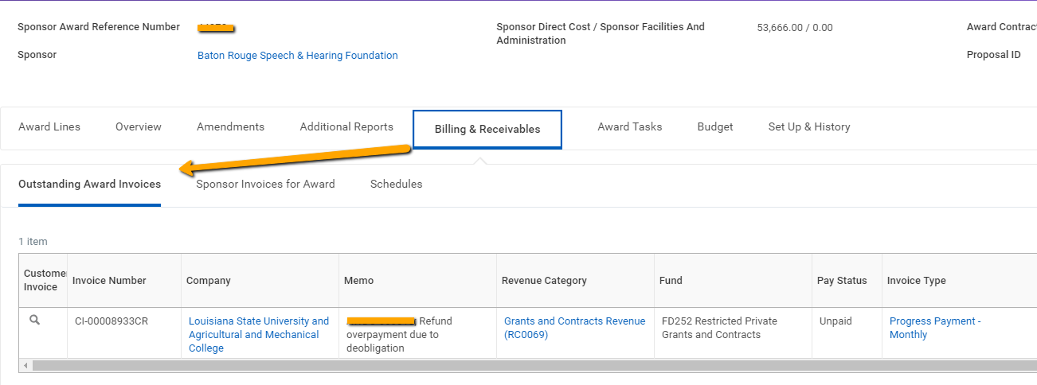
Viewing Outstanding Invoices on Award Tab
Lists all unpaid invoices associated with an award (not including any outstanding AR as of 6/30/2016)
If a payment is pending, invoice will still be considered “Unpaid” until payment application is approved.

Slide 25
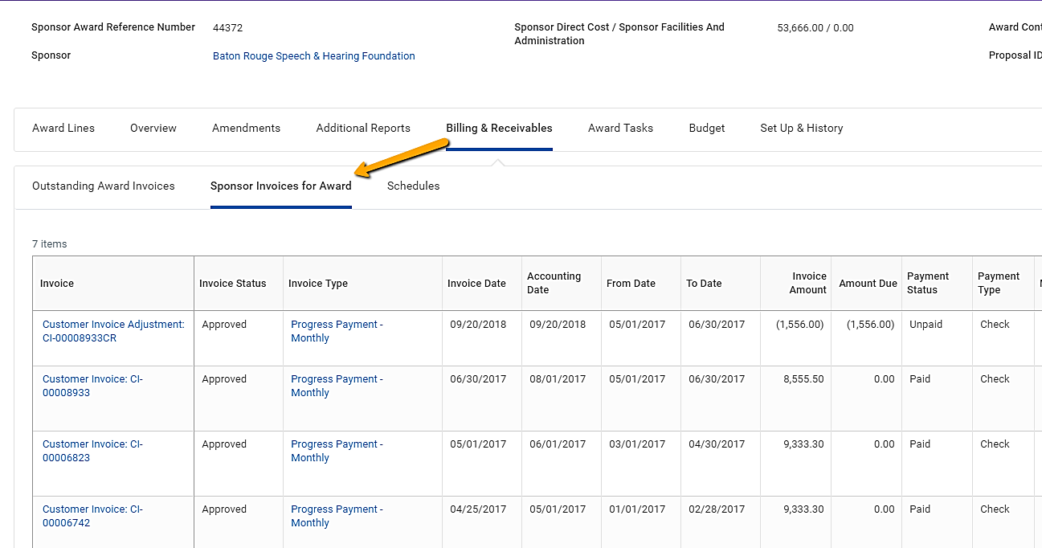
Viewing Sponsor Invoices on Award
Lists all customer invoices (approved/draft/in progress) associated with an award including the amount due and payment status.
Does not include any outstanding AR as of 6/30/2016 (conversion balances).

Slide 26
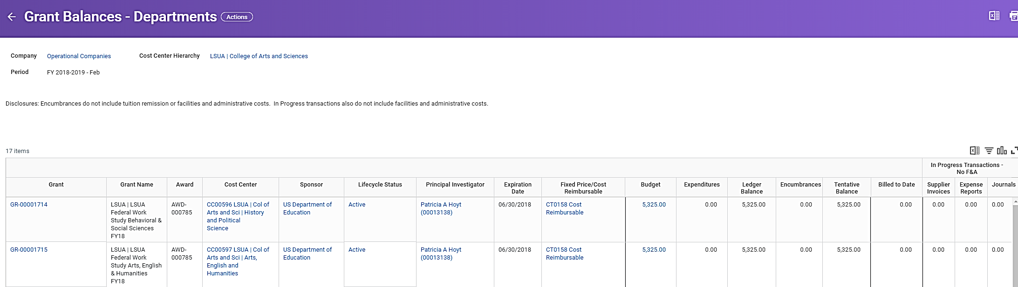
Reports: Grant Balances – Department (COMING SOON)
Report can be run by Cost Center or Cost Center Hierarchy.
Intended to help departmental administrators view a balance summary report of their awards/grants with additional fields such as PI and Expiration date.
Disclaimer: Does not include F&A or Tuition Remission on Encumbrances or In Progress Transactions. In Progress columns do not include Payroll Accounting Adjustments (PAAs). Report does not include Tentative (not attached to an award) or Inactive Grants.

Slide 27
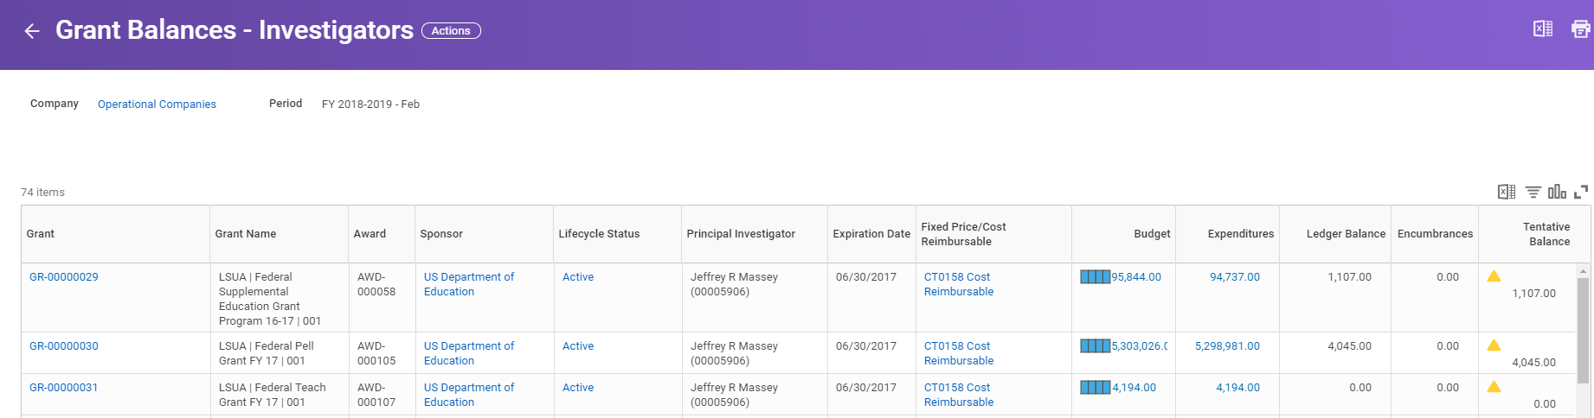
Reports: Grant Balances – Investigator (COMING SOON)
Report runs based on the user’s roles on awards (just click OK, do not have to populate the fields)
Report is intended to provide a summary view of balances for PIs and Co-PIs
Disclaimer: Does not include F&A or Tuition Remission on Encumbrances. Does not include In Progress Transactions (supplier, expense reports, journals). Does not include Tentative (not attached to an award) or Inactive Grants.

Slide 28
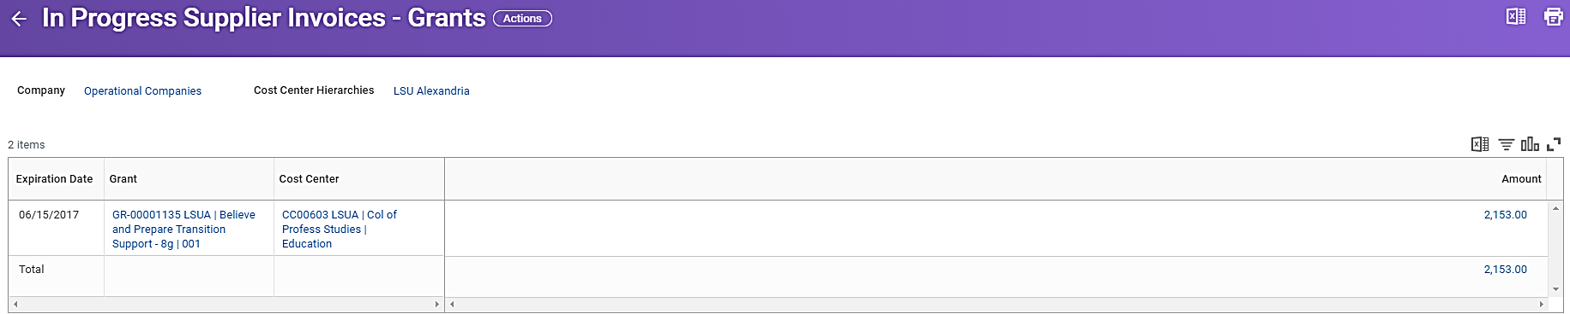
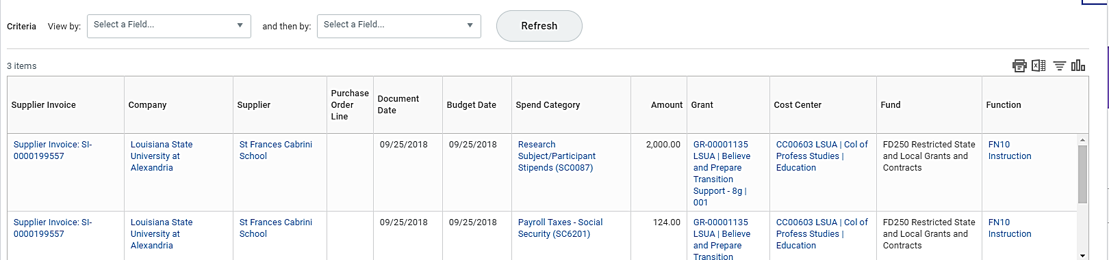
Reports: In Progress (COMING SOON)
All three In Progress reports (supplier, expense reports, journal entries) only pull transactions related to grants
Report is intended to provide a list of In Progress transactions, subtotaled by grant, for a given cost center or cost center hierarchy.

Slide 29
AS-21 Policy Update

Slide 30
AS-21 Unallowable Costs for Sponsored Agreements
  Notice of Unallowable Costs on Sponsored Program Account letter/email
    SPA analyst will email the department grant analyst and PI notifying them of unallowable expenses and requesting the charge be moved.
    If the charge remains on the account the SPA analyst will move the charge (journal entry or PAA) from the grant account to the SPA unallowable cost account
    A SPA unallowable cost account will be established in each College for each function (i.e. Instructional, Research, Public Service). These will be unrestricted accounts (FD100).

Slide 31
Questions

Slide 32
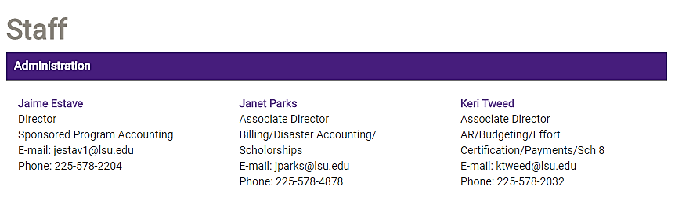
SPA Staff
https://www.lsu.edu/administration/ofa/oas/spa/spastaff.php

Slide 33
The End

