Slide 1

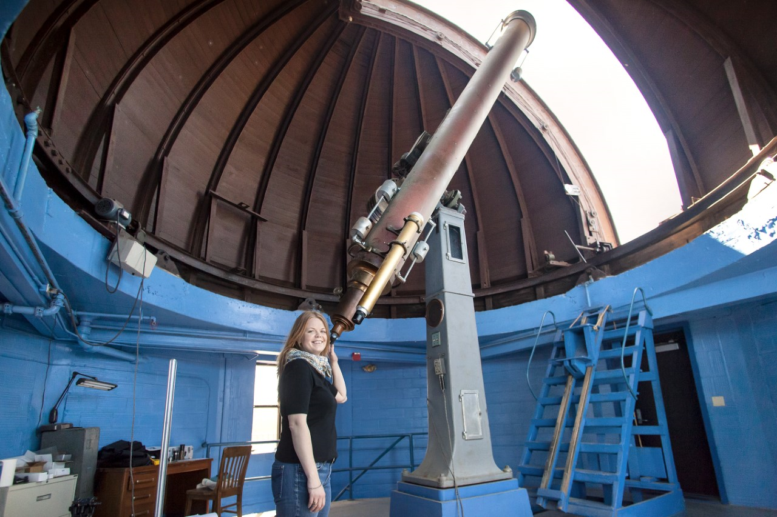
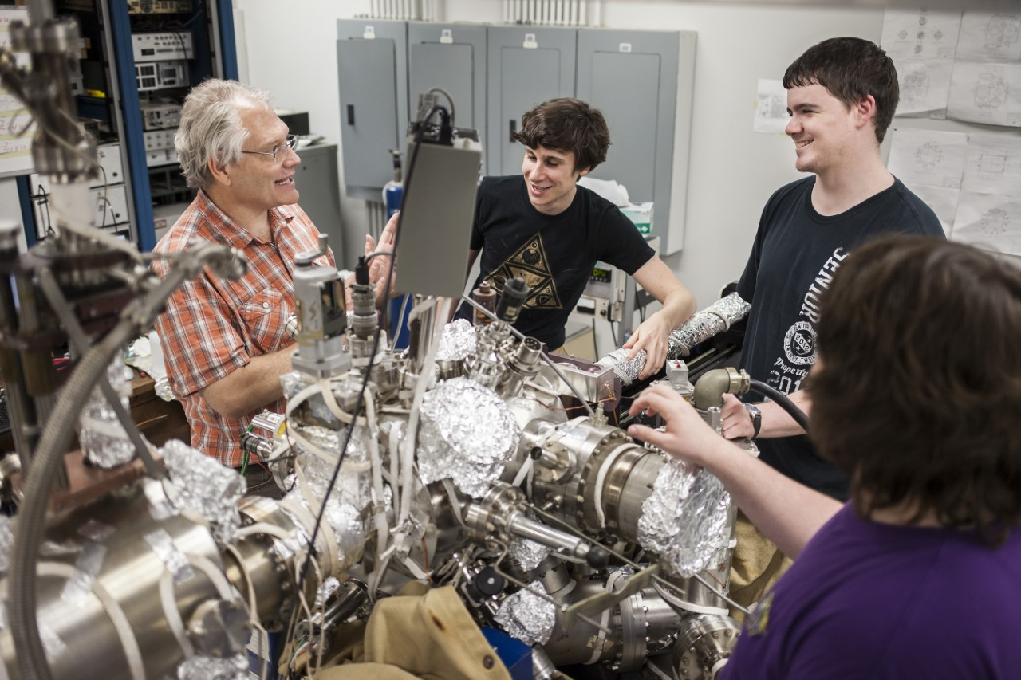
Envision yourself exploring our place in the universe
What to do with a physics degree?
Have a solid foundation to attend graduate school in the physical sciences
Work in a government or industrial lab
Work in a hospital as a medical physicist
Apply problem-solving skills to analyze the behavior of the stock market for major banks
Go to Medical School
Go to Law School
Why study physics?
Understand how the universe works
Solve challenging problems
Develop cutting-edge technologies to transform our world
Work where students actively participate in real research and attend conferences
Study one of the most flexible science fields
Visit us at www.lsu.edu/physics/

