Slide 1
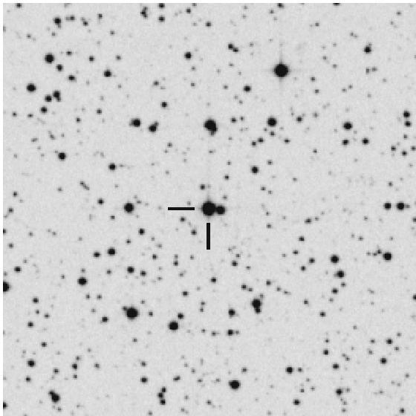
Figure 1:
Currently, V Sagittae (V Sge) is just a faint inconspicuous star in the constellation of the “Arrow” (with a formal Latin name of “Sagitta”). Indeed, the Arrow is pointing directly at V Sge. This picture shows a close up of the star field around V Sge, where the point of this picture is that V Sge now appears as an ordinary and inconspicuous star.
This image is taken from the POSSII plate, with the faintest visible stars near 21st magnitude, north is to the top, and east is to the left. V Sge is indicated by the two hash marks. This image is a ‘negative’, where the stars are dark circles and the background sky is white. The field is 5X5 arc-minutes, an area comparable to Mare Imbrium on our Moon.

Slide 2
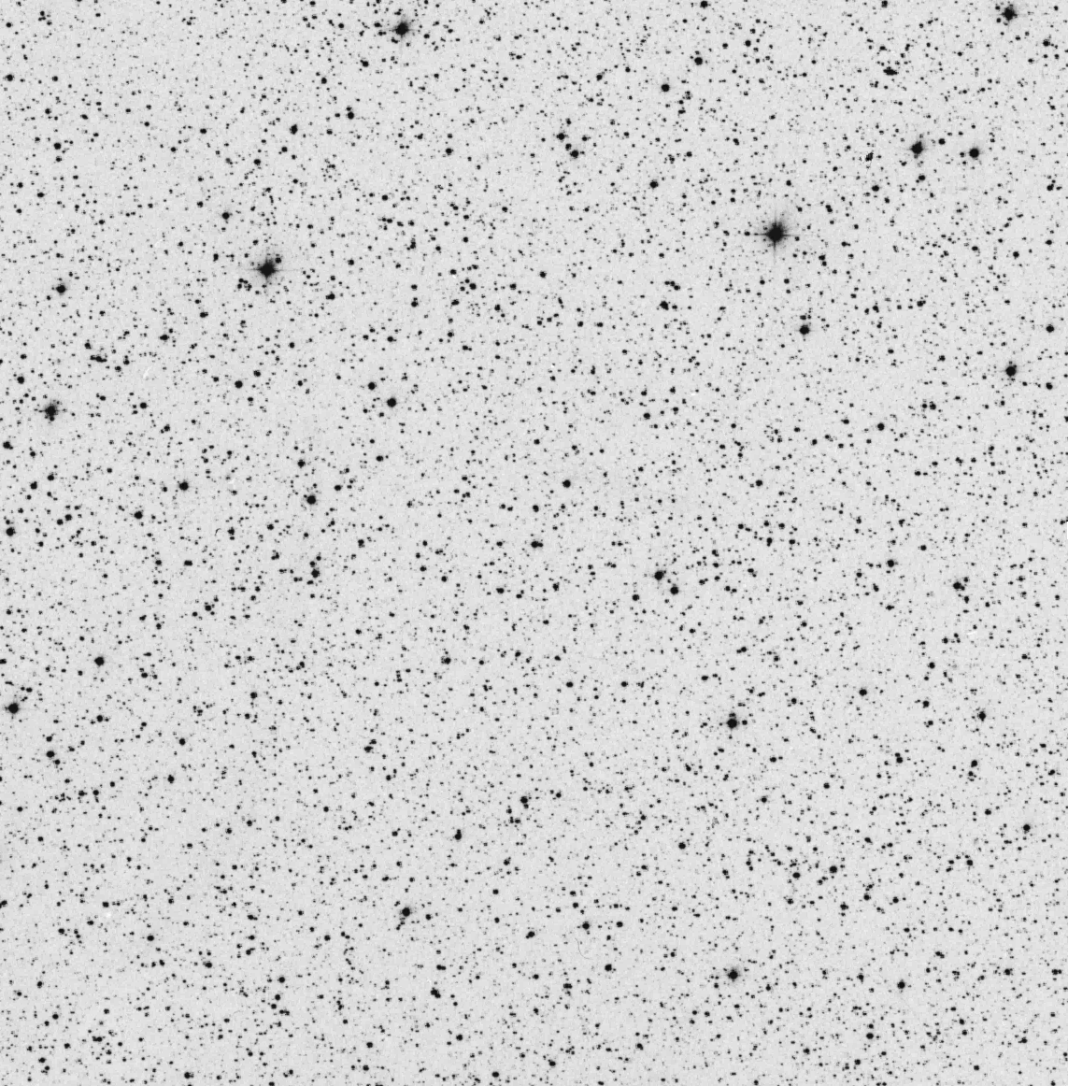
Figure 2:
This is another view of the star field around V Sge, this time with the field covering the size of our Full Moon. The brightest stars in this image are 9th magnitude (needing binoculars and a dark sky to be visible), and V Sge is the much smaller dot in the center (indicated by the small arrow). It now takes a middle-sized telescope to see V Sge visually. The point of this image is to emphasize that currently, V Sge is faint and inconspicuous, in stark contrast to the great brightness predicted for around the year 2083 AD.
This image is taken from the POSSII plate, with the faintest visible stars near 21st magnitude, north is to the top and east is to the left. V Sge is indicated by the small red arrow in the center. This image is a ‘negative’, where the stars are dark circles and the background sky is white. The field is 30X30 arc-minutes, an area in which our Full Moon would just fit.

Slide 3
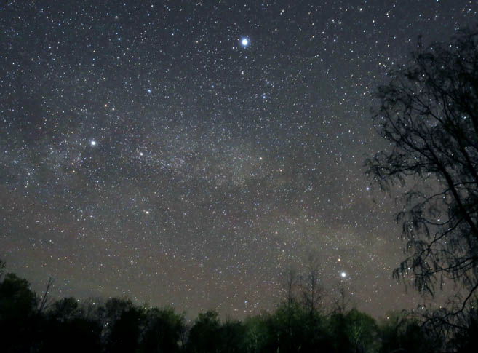
Figure 3a:
Sagitta (the Arrow) is a constellation on the edge of the iconic Summer Triangle, defined by the three stars Vega (in Lyra the Lyre), Deneb (in Cygnus the Swan), and Altair (in Aquila the Eagle). The Arrow consists of five stars in an arrow-shape, pointing right at V Sge. Figure 3 has three panels, with the first panel just the beautiful image of the Summer Triangle above a tree-filled horizon setting the scene.
The base image for all of Figure 3 is taken from a sky-photo by Bob King that appears on the Sky & Telescope web page. https://www.skyandtelescope.com/observing/the-summer-triangle-makes-its-midnight-debut/

Slide 4
Figure 3b:
Sagitta (the Arrow) is a constellation on the edge of the iconic Summer Triangle, defined by the three stars Vega (in Lyra the Lyre), Deneb (in Cygnus the Swan), and Altair (in Aquila the Eagle). The Arrow consists of five stars in an arrow-shape, pointing right at V Sge. Figure 3 has three panels, with this second panel being an annotated version of Figure 3a.
The base image for all of Figure 3 is taken from a sky-photo by Bob King that appears on the Sky & Telescope web page. https://www.skyandtelescope.com/observing/the-summer-triangle-makes-its-midnight-debut/
Vega
Summer Triangle
Deneb
Sagitta
V Sge
×
Altair

Slide 5
Figure 3c:
Sagitta (the Arrow) is a constellation on the edge of the iconic Summer Triangle, defined by the three stars Vega (in Lyra the Lyre), Deneb (in Cygnus the Swan), and Altair (in Aquila the Eagle). The Arrow consists of five stars in an arrow-shape, pointing right at V Sge. Figure 3 has three panels, with this third panel showing the predicted scene around the year 2083, with V Sge appearing as a ‘Guest Star’ as bright as Sirius, and possibly as bright or brighter than even Venus.
The base image for all of Figure 3 is taken from a sky-photo by Bob King that appears on the Sky & Telescope web page. https://www.skyandtelescope.com/observing/the-summer-triangle-makes-its-midnight-debut/

Slide 6
Figure 4:
V Sge is a binary star, consisting of a normal 3.3-solar-mass normal star orbiting around a 0.85-solar-mass white dwarf, all going round-and-round every 12 hours. The orbital plane is nearly seen edge-on, so the star system appears much dimmer when the normal star eclipses the white dwarf, and a secondary eclipse when the white dwarf eclipses the normal star. These primary and secondary eclipses can be seen in this ‘light curve’, a plot of the star’s brightness over time. We see that these eclipses are superposed on top of substantial chaotic variability.
This plot is using the awesome light curve from the TESS satellite, for 2.5 days in July 2019. The vertical axis is the star’s brightness in units of magnitudes, with bright points at the top and dimmer points at the bottom.

Slide 7
Figure 5:
V Sge is an eclipsing binary, and astronomers having been timing the instant of minimum light ever since 1962. If the orbit is perfectly stable, then the time differences in the plot would be perfectly flat. But if the orbit is decreasing fast, then the plot would show a concave-down parabola. The best fitting parabola shows the largest known curvature for any CV, and curve is concave downward. This is a proof that the orbit of V Sge is in-spiraling fast.
This plot is constructed from 183 eclipse times, with the critical early times pulled out from the Harvard plates, and the 2019 points from the TESS light curve.

Slide 8
Figure 6:
The critical new input is that V Sge is brightening fast, very fast. This means that the accretion rate (the rate of mass falling off the normal star) must be rising exponentially. And this proves that the orbit is getting smaller, fast, which is to say that the orbit is in-spiraling. With this, the fate of V Sge is sealed, the death-spiral leading to a merger of the two stars is assured.
This plot is constructed from 68016 individual magnitudes taken from the AAVSO data base, all exactly converted to the standard Johnson V magnitude system. The plotted points represent five-year averages. There is substantial scatter due to the usual chaotic variability of V Sge. The best fit straight line in magnitude-versus-year corresponds to an exponential increase in flux and accretion rate, with a doubling time scale of 89 years. This same exponential rise i\was first seen in blue light, where the light curve was made from 1531 magnitudes from the Harvard plates and from AAVSO CCD measures.

Slide 9
Figure 7:
V Sge is a system where a hot massive star is in a close orbit around a white dwarf. Gas is falling off the normal star at a huge rate, forming a stream out of the point of closest contact, going into a circular disk around the white dwarf. The surface of the normal star is hot (about 12,000 K), so it appears bluish-white. The white dwarf region is very hot and bright, so it irradiates the inner hemisphere of the normal star (although the disk itself casts a shadow), heating up its gases. Even now, V Sge has an incredibly large stellar wind, where much of the overflowing mass is accelerated away from the white dwarf, forming a heavy shroud that partly hides the inner system in a bright haze.
This plot is constructed from BINSIM (http://www.phys.lsu.edu/~rih/binsim/) by LSU Professor Robert Hynes. The key point is that this picture is an accurate depiction of what V Sge looks like currently.

