Slide 1



Slide 2


Who We Are
SAA Mission
  To advocate, engage and support students through educational interventions that foster their development
SAA Vision
  Enrich the student learning experience to foster the highest standards of academic and personal conduct, while positively contributing to individual development consistent with the LSU Commitment to Community.

Slide 3
Who We Are cont...
Our teams advocates for our students
We engage and support student through education interventions
SAA enriches the student learning experience to the high standards of academic and personal conduct
We positively contribute to the individual development consistent with the LSU Commitment to Community

Slide 4

Code of Student Conduct
Scan to view the Code of Conduct
  Behavioral Misconduct
  Academic Integrity
  Student Organization Conduct (Hazing)
  Amnesty Policy
  Violation of the Law can be violation of the Code
  LSU has jurisdiction on and off campus

Slide 5
Academic Misconduct Cases:
Academic Integrity
“High standards of academic integrity are crucial for the University to fulfill its educational mission. To uphold these standards, procedures have been established to address Academic Misconduct. A Student is responsible for submitting work for evaluation that reflects the Student’s performance. If a Student has a question regarding the Instructor’s expectations for assignments, projects, tests, or other items submitted for a grade, it is the Student’s responsibility to seek clarification from the Instructor.”
  Collaboration
  Copying
  Failure to follow course requirements
  False Information
  Misrepresentation
  Plagiarism
  Unauthorized Materials

Slide 6
Academic Misconduct Question for you!
What is the most common Academic Misconduct case type?
-Collaboration
-Copying
-False Information
-Misrepresentation
-Plagiarism
-Unauthorized Materials

Slide 7
Behavioral Misconduct Question for you!
What is the most common Behavioral Misconduct case type?
-Alcohol / Drugs
-Disorderly Conduct
-Failure to Comply
-Theft
-Endangerment
-Residential Life

Slide 8
Misrepresentation
Misleading an Instructor as to the condition under which the work was prepared including, but not limited to, undisclosed Artificial Intelligence (AI) use, substituting for another Student, or permitting another person to substitute for oneself on any academic work.

Slide 9


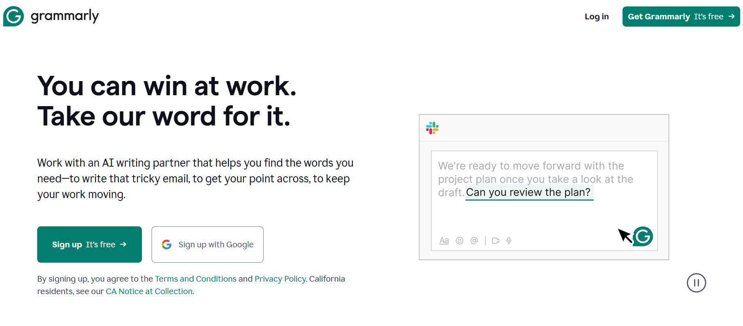
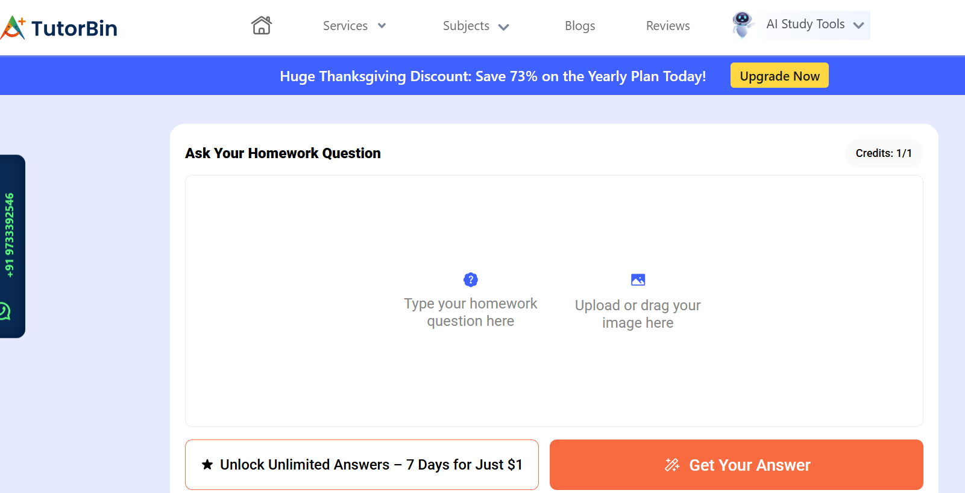

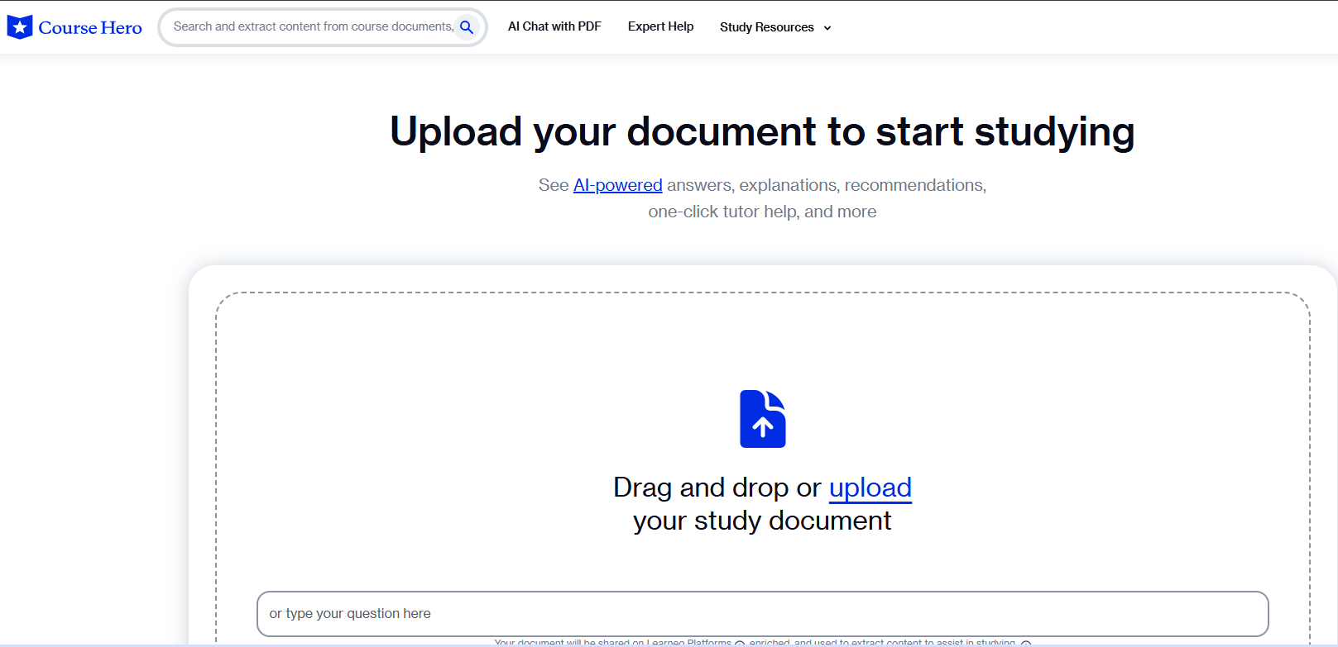
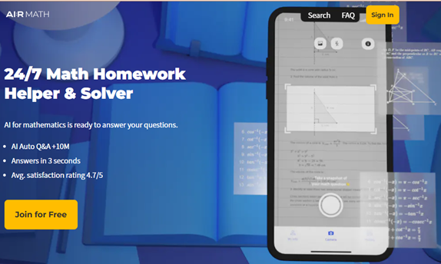
LSU Trends: AI Software

Slide 10
Use of AI is not inherently bad…
Submission of work that is not representative of a student’s own knowledge and skills is the problem.
AI Software continued
Notes:
Villainizing AI will not help prevent acts of misconduct. Students often think the instructor won’t be able to tell the difference.

Slide 11
Spectrum of Permissible Use
Permitted
Prohibited
Permitted within specifications
Notes:
AI is a supportive tool, not a substitute for learning.
It should enhance understanding, not complete assignments on a student’s behalf. Also, always cross-check AI outputs for accuracy and bias.
On one hand, AI can genuinely help students learn by offering quick feedback, personalized tutoring, and creative brainstorming support. It can enhance understanding and save time, which is especially valuable for student-athletes managing tight schedules.
However, when AI is misused — for example, when students use it to generate entire assignments without contributing their own effort — it crosses into academic integrity concerns.
The challenge is helping students understand where the line is between helpful assistance and unethical shortcuts. This is a learning curve not just for students, but for educators and support staff as well.
The takeaway here is that AI is not inherently good or bad — it depends on how it’s used. Our role is to guide student-athletes to use these tools to enhance learning while maintaining integrity.
One major challenge is that policies vary widely between departments and even individual instructors.
As support professionals working with student-athletes, it’s crucial that we stay informed about our own institution’s policies — and help translate them for our students in clear, practical language.
To uphold academic integrity, universities are investing in AI-detection tools such as Turnitin’s AI-detection feature. Detection is only part of the solution. The bigger goal is fostering a culture of integrity, so students choose ethical paths before detection even becomes necessary.

Slide 12
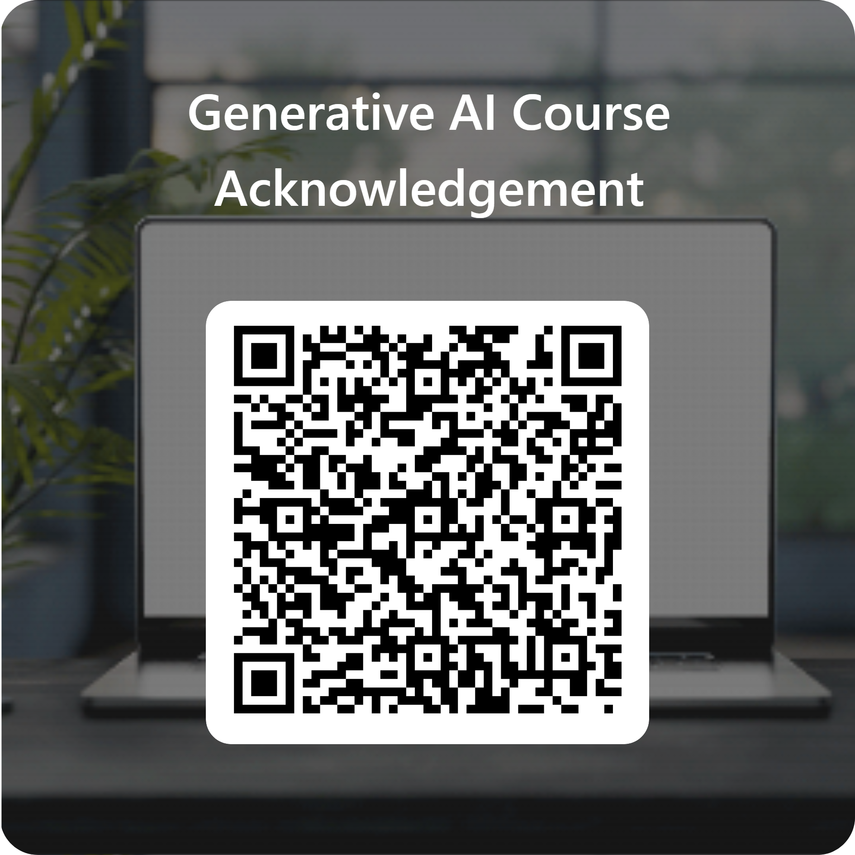
Generative AI Course Acknowledgement
Notes:
Ask students to look at the course syllabus and share if AI per permitted, prohibited, or permitted within specifications. Then ask them to pull out their phones and complete the acknowledgement. This should only take about 2 minutes.

Slide 13
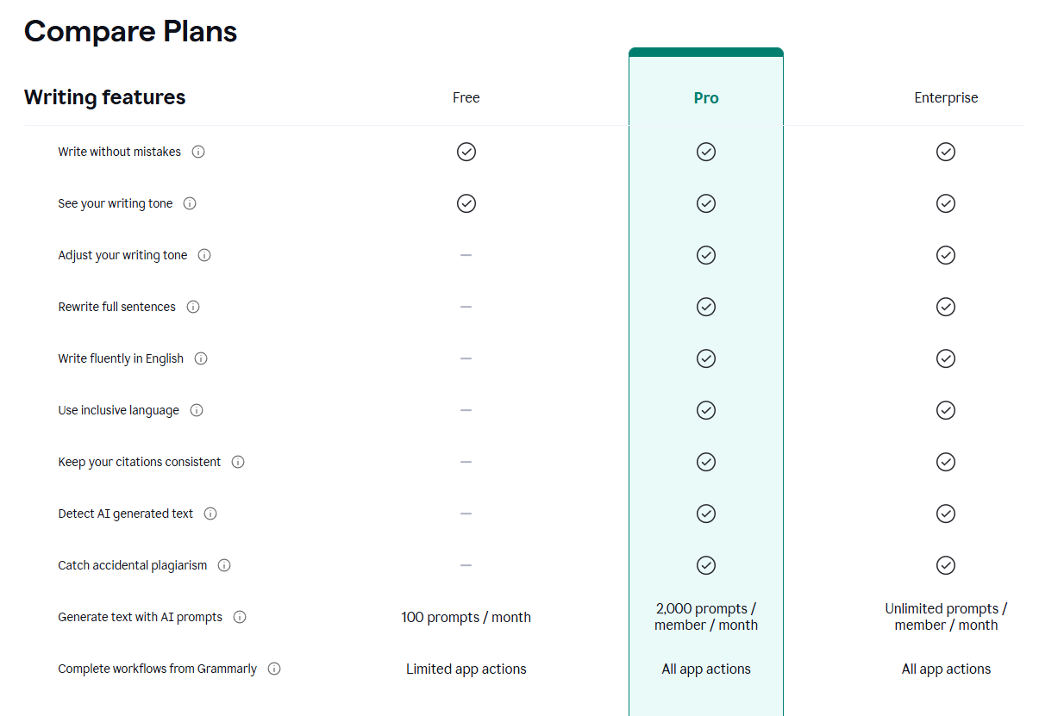
Grammarly IS
AI Software
LSU Trends: Grammarly

Slide 14
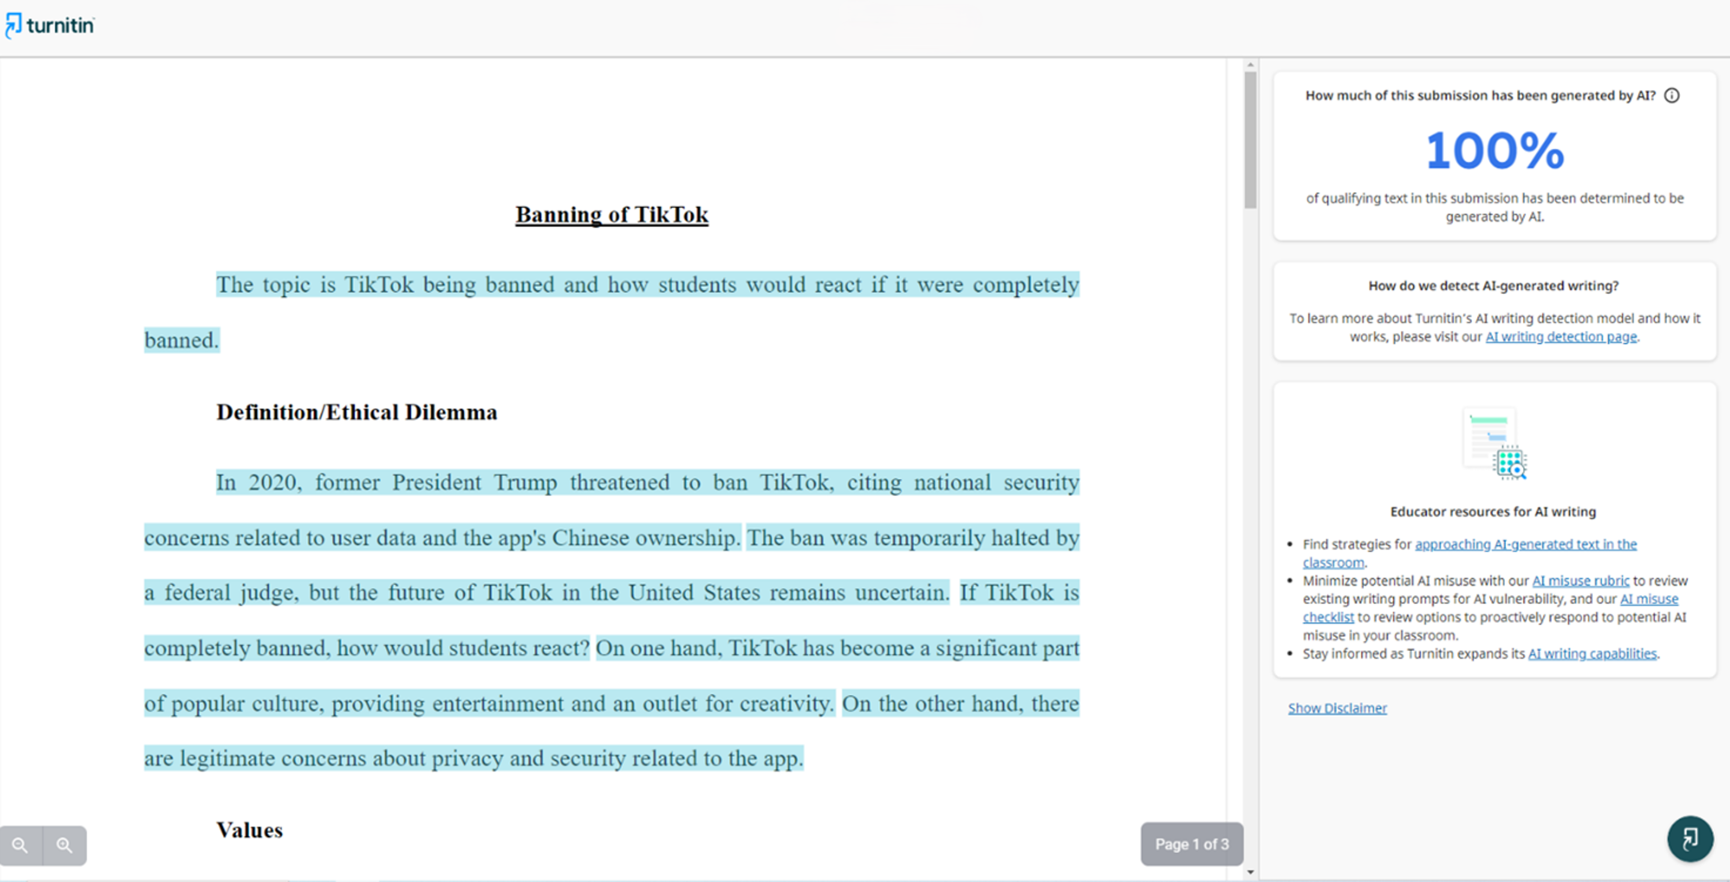
LSU Trends: Turnitin

Slide 15
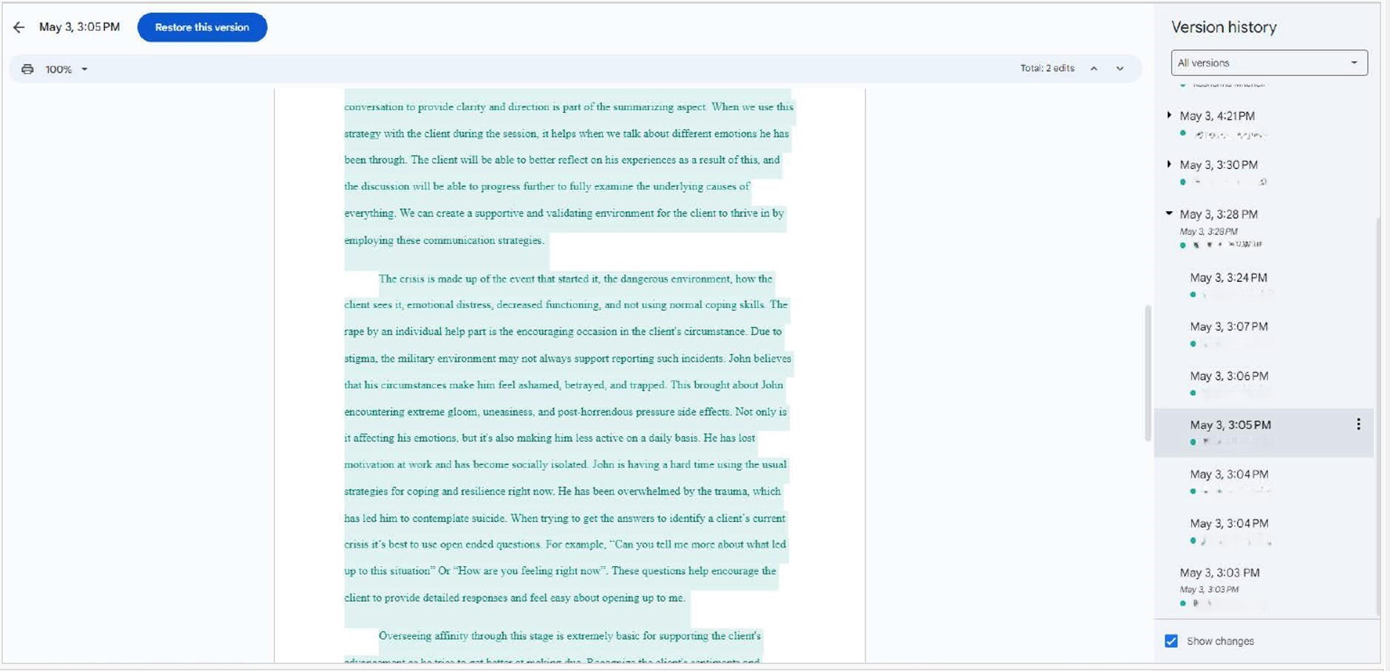
LSU Trends: Version History

Slide 16

  Lack of appropriate citation, or the unacknowledged inclusion of someone else's words, structure, ideas, or data; failure to identify a source, or the submission of essentially the same work for two assignments without permission of the Instructor.
Plagiarism

Slide 17
Plagiarism
  Appropriate Citation includes:
  In-text citations *and*
  Quotations *and*
  Works Cited (or Reference Page)
  All citations/quotations must be included to avoid a violation of Plagiarism.

Slide 18
Case Study
You are completing an assignment but want to restructure the sentencing format. You have heard Grammarly can do this for you easy and quickly, but you are unsure if this is allowed in the specific course. There is nothing in the syllabus to lead you in the right direction.
Reach out to the course instructor before using Grammarly and ask if this is something they allow in their class. Be specific and explain what you are using Grammarly for.

Slide 19
Case Study #2
Scenario: You are a college student at LSU, enrolled in ENGL 1001, a course required for your major. You've been struggling to generate ideas for your final essay.
Dilemma: A friend shares their experience with ChatGPT, an AI writing program, which helped them with their ENGL 1001 final essay. You decide to use ChatGPT to generate a topic and it not only provided a topic, but also a full essay. You integrate both the AI-generated topic and sections of the essay with your original content and submit the assignment to your Professor.

Slide 20
Prevention
  Read ALL Syllabus, assignment instructions, and other documents provided by the instructor
    Check for syllabus statements for AI & Collaboration
  ALWAYS cite your sources
  Only use approved/authorized sources
    Do not use test banks, Chegg, Coursehero, Spark Notes, or other “tutoring” websites.
  Take the SAA Moodle Module
  Use Google Docs
  Ask the instructor if you are unsure of something.

Slide 21
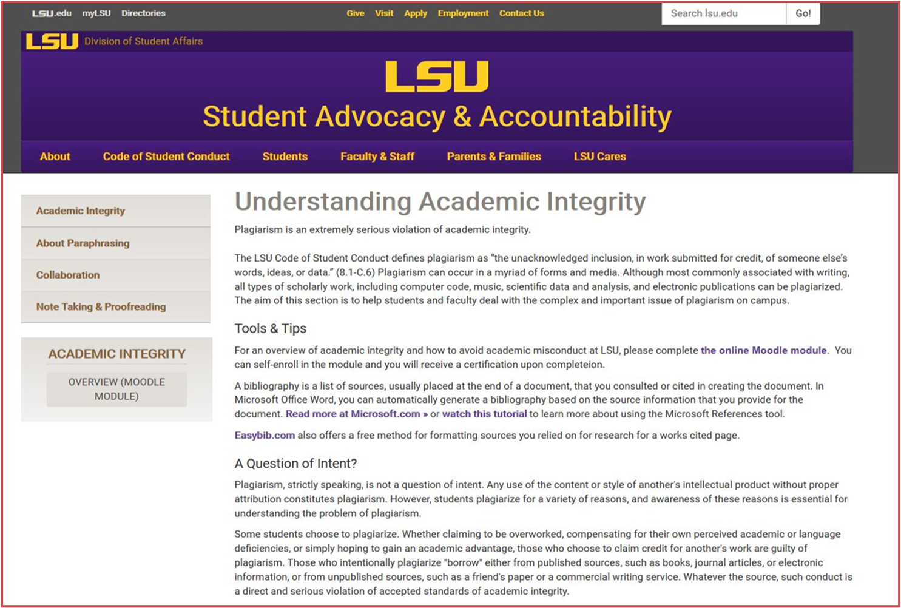

Slide 22
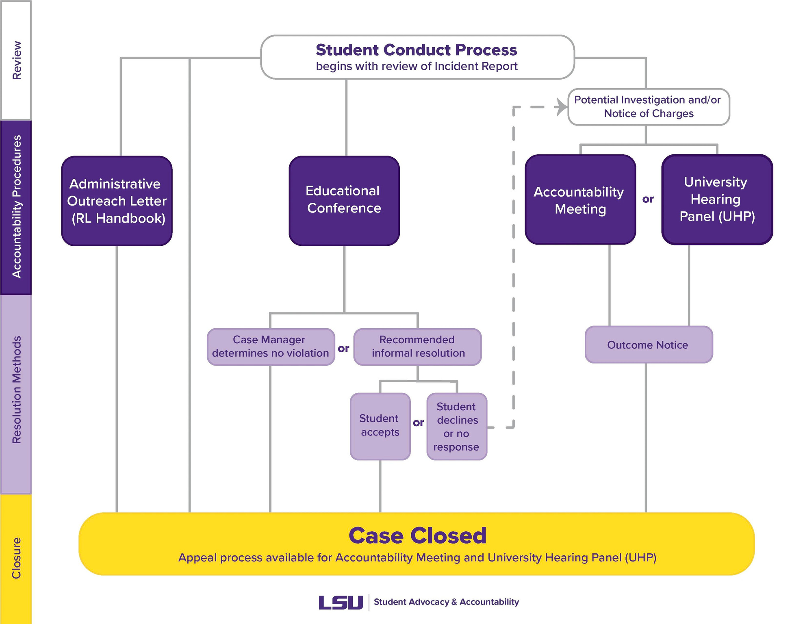

Slide 23
Accountability Outcomes
Typical Outcomes for Undergraduate Students
1st Violation: Warning for a minimum of two semesters (including a transcript notation)
Zero on the work in question
Educational activity: Academic Misconduct Moodle Module, Plagiarism Moodle Module, Assignment Resubmission for no credit, Letter of Apology, Ethics & Decision Making Moodle class, etc.
Typical Outcomes for Graduate Students
1st Violation: Disciplinary Probation for a minimum of two semesters (including transcript notation)
Zero on work in question and lower the overall grade by one letter OR fail the course.
*Student records are kept for 7 years, unless a student was suspended or expelled.

Slide 24
Graduate Students are held to a higher standard because of the advanced level of study and the increased responsibilities that come with it.

Slide 25
HELP PREVENT
HAZING
Hazing is an act by an individual or a group that, as an explicit or implicit condition for initiation to, admission into, affiliation with, or continued membership in a group or organization, regardless of consent, endangers health and safety, compromises academic performance, causes property destruction, or violates policy or law
Report hazing: 225-578-3231 (LSUPD) or www.lsu.edu/concern

Slide 26


Slide 27
We are here to support you!
Student Advocacy & Accountability
4th Floor of the Student Union
(225) 578-4307
dossaa@lsu.edu

